Slide 1
LABORATORY SAFETY AND SCHOOL SAFETY TOO!

Slide 2
School Safety
ID’s should be on at all times....
Why?
So if something goes wrong, we know who you are and can account for you.
Drills:
Fire drill, earthquake drill, tornado drill, code red lock down, code yellow lock down

Slide 3
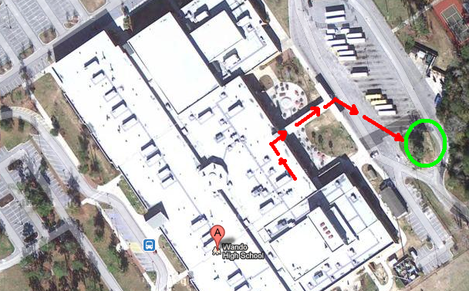
Fire Drill
We are going towards the green circle…
Find and meet at the “Mr. Banker Sign”

Slide 4
Tornado Drill
Move into the hallway in front of our classroom
Face a wall, get down on your knees, duck and place your head between your knees, and hold your hands over your head.

Slide 5
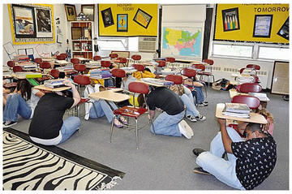
Earthquake Drill
Stay in the classroom
“Duck and Cover”
under your desk

Slide 6
Code YELLOW Lock Down
This drill is if there is a local disturbance (bank robbery, stick-up at Walmart, etc.)
Class continues as normal BUT…
There are no bells and we stay in this room until the yellow lock down drill is over.
It could technically last past the end of school.
NO CELL PHONES
Bathroom breaks are only allowed if you are accompanied by security / administration

Slide 7
Code RED Lock Down
This drill is if there is an armed intruder in the building
Class stops.
All doors are locked.
The window near the front of the room is covered
The lights are turned off
We all, QUIETLY, hide in the back of the classroom, behind lab benches and walls, so that we can’t be seen or heard from the back door.
Green Cards are placed under door if we are all OK
Red Cards are placed under door if someone is hurt
NO CELL PHONES and NO LEAVING THE ROOM

Slide 8
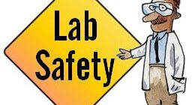
Science Laboratory Safety
Where are/is the:
Trash Cans?
Recycle Bins?
Fire Extinguisher?
Fire Blanket?
Fire Alarm (to alarm us?)
Fire Alarm (to pull and alarm others?)
Chemical Shower?
Chemical Eye Wash?
Back Laboratory Prep Room?

