Slide 1
Rube Goldberg Machine Project!

Slide 2
You will be building Rube Goldberg Machines!
Clear your desk except for a pen or pencil

Slide 3
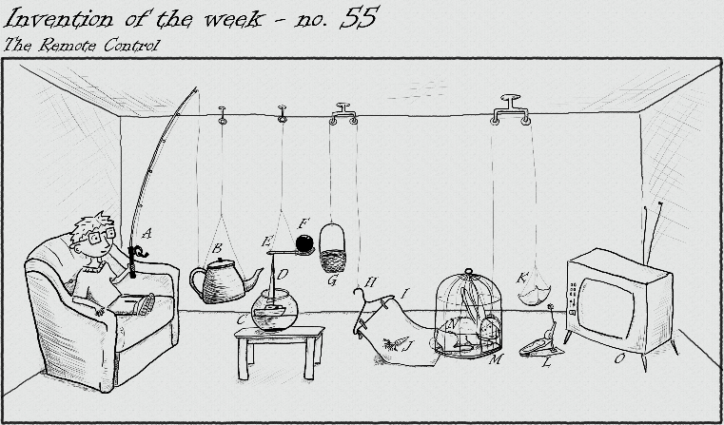
What the heck is a Rube Goldberg Machine?
A combination of simple machines which completes a task or goal.

Slide 4
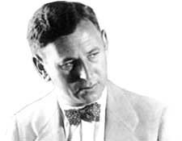
Who the heck is Rube Goldberg?
Reuben Lucius Goldberg
1883-1970
Born in San Francisco
Most famous for his complex systems that would perform basic tasks.

Slide 5
Welcome to the Invention Convention
Hello my fellow inventors,
For the next week we will be developing a mock Rube Goldberg machine.
You will be assigned a specific task your group must complete.
Have a better idea not already taken? Get it approved by your teacher and you can do it!
You will be assigned to a new group for this project.

Slide 6
Invention Convention
On January 6th we will showcase our inventions to all 9th grade classes during this period at the Invention Convention.
The first place machine during each period will win 10 additional points on their final Rube score.

Slide 7
Keep in mind…
Please use the following topics we have covered in class to benefit your project:
Forms of Energy
Conservation of Energy
Energy Diagrams

Slide 8
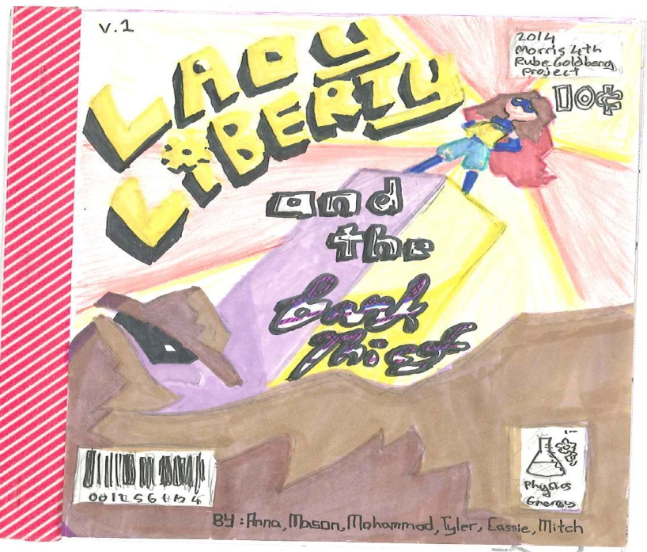
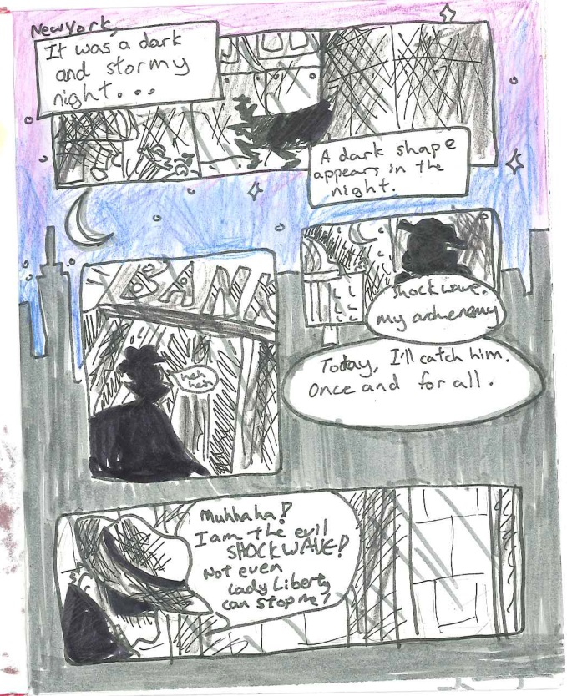
Ok… ok… can we see more examples?
Comic Strip example – hard copy available in C-211 → This is the cover and first page.
Notes:
PDF in dropbox

Slide 9
Ok… ok… can we see more examples?
Commercial example
https://www.youtube.com/watch?v=YWk9N92-wvg
Homemade example
http://www.youtube.com/watch?v=lCYg_gz4fDo
Music Video example
http://www.youtube.com/watch?v=qybUFnY7Y8w

Slide 10
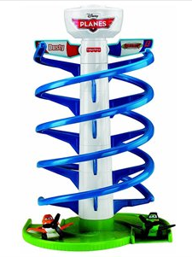
Parameters
What the heck can’t I use?
Power tools
Anything that is already constructed
Materials from around my room without permission
What the heck can I use?
Anything school appropriate that you bring in!
Approved materials from your teacher but MUST be checked out prior

Slide 11
Where the heck do I start?
Get together with your group
Exchange contact information
Pick a presentation form
You must tell your teacher TODAY which presentation form you are choosing.
Begin working on your project
Blueprint – due next class (mid class)
Bring supplies next class

Slide 12
What the heck is a blueprint?
Show machine from multiple angles
Label materials used
Make sure it would work
Someone else who is not in your group should be able to understand your blueprint.

Slide 13
Today’s Goal
Pick a design
You must tell your teacher TODAY which presentation form you are choosing.
Begin working on your project
USE YOUR TIME WISELY
Blueprint

Slide 14
Science Log
Today’s Date:
Wednesday, December 16, 2015
Homework:
Bring materials to start project next class
Rube Goldberg Blueprint – due half way through class

