Slide 1
Atomic Structure

Slide 2
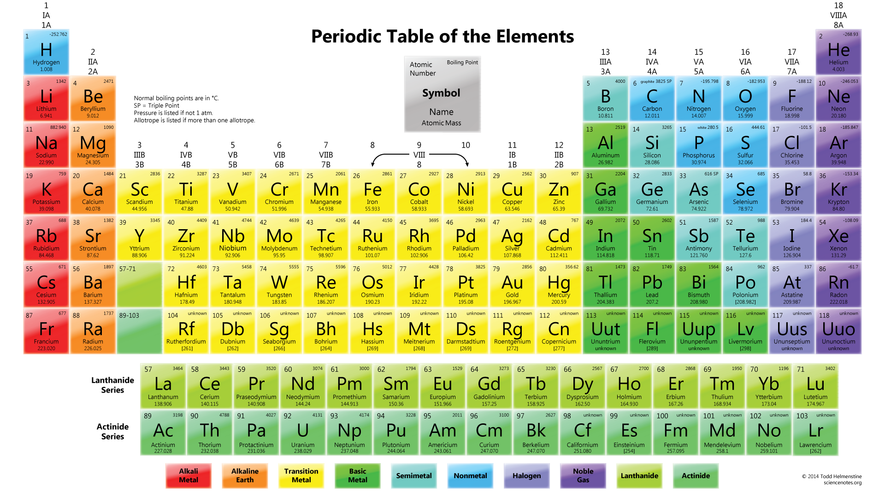
Periodic Table of Elements

Slide 3
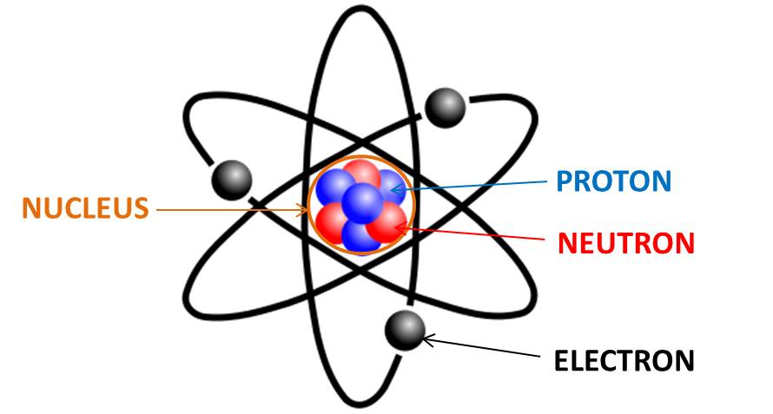
What Is in an Atom?
Definition: An atom is the smallest unit of an element. An atom is made up of three subatomic particles.
Comprised to two main parts
Nucleus – center portion containing protons and neutrons.
Contains Protons and Neutrons
Electron Cloud – outside orbitals where electrons surround the nucleus.
Contains Electrons

Slide 4
Subatomic Particles
The subatomic particles are distinguished by their charge, mass, and location.
Each has a different “job” to do with respect to its structure.
Particle | Location | Charge | Mass | “Job”
Proton | Nucleus | +1 | ~1amu | Determines identity of element
Neutrons | Nucleus | 0 | ~1amu | Supplies proper mass to hold nucleus together
Electrons | Electron Cloud | -1 | ~0 amu | Determines bonding and reactivity

Slide 5
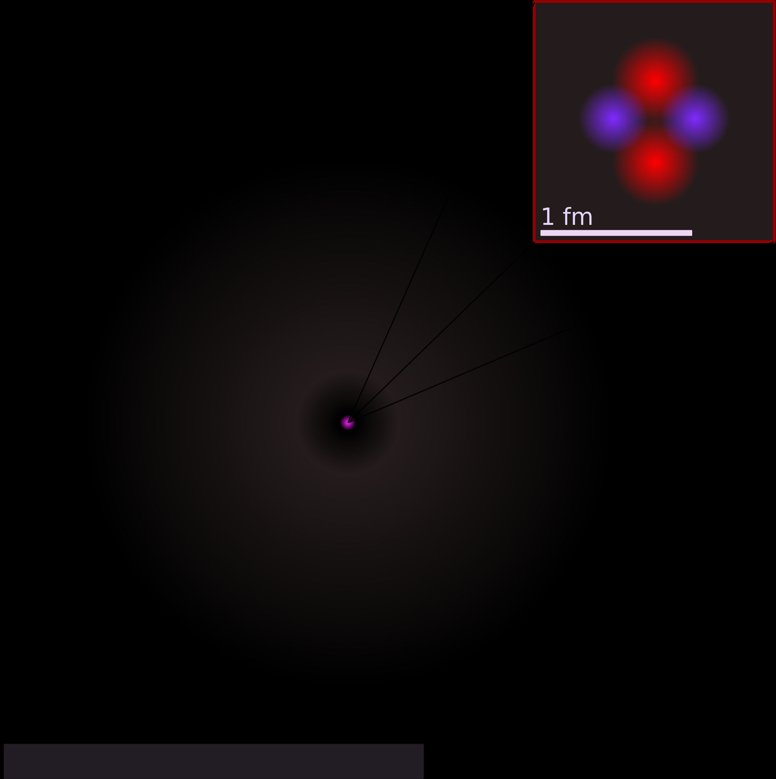
Empty Space!
Atoms are mostly empty space…. Seriously!
Proper Proportioned Giant Atom of Science!

Slide 6
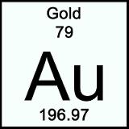
Atomic Number
Definition: The number of protons in the nucleus of an atom.
The number of Protons identify the atom. Change the atomic number and you have a new element!

Slide 7
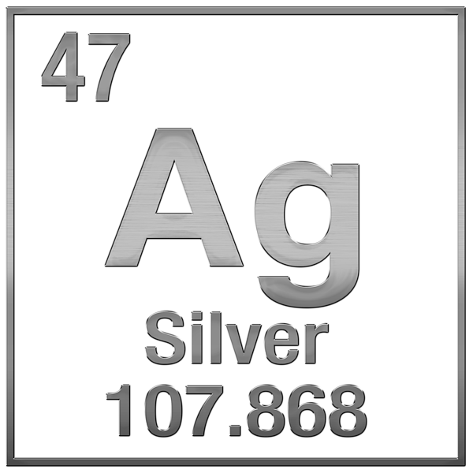
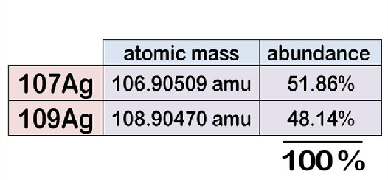
Average Atomic Mass
The average mass of all the atoms that make up this element.

Slide 8
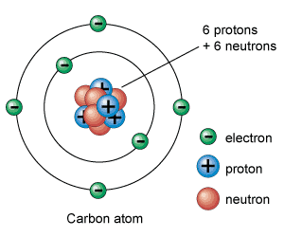
Mass Number
The mass number equals the total number of subatomic particles in the nucleus.
#Protons + #Neutrons = Mass Number

