Slide 1
Chemical Reactions

Slide 2
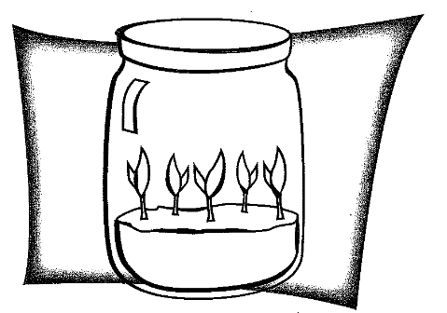
Seedlings in a Jar
The total mass of the original jar with seeds will be more than the total mass of the jar with the seedlings.
The total mass of the original jar with seeds will be less than the total mass of the jar with seedlings.
There will be no change in the total mass of the jar with seedlings
The Law of Conservation of Matter:
Matter cannot be created nor destroyed.
So… Whatever atoms a chemical reaction begins with, then the chemical reaction must end with the exact atoms in the same amounts.

Slide 3
Chemical Reactions
Chemical Reactions occur when bonds are broken and a new product is formed. (Chemical Change)
Involve the rearrangement of atoms
How do you know if a chemical change has taken place?
All chemical changes are results of chemical reactions.

Slide 4
Chemical Equations
Chemical formulas are used to write chemical equations.
The chemical compounds used to start the reaction are Reactants.
The chemical compounds at the end of the reaction are Products.

Slide 5
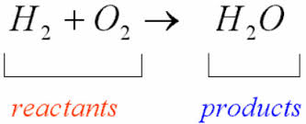
Chemical Equations

Slide 6
Reaction Symbols
There are several types of Reaction symbols used.
+ plus (added to)
→ forms (produces or yields)
(g) gas
(s) solid
(l) liquid
(aq) aqueous solution
Placed after a chemical symbol in a reaction to note the state of matter

Slide 7
The Copper Cycle Lab
Purpose: To examine the Law of Conservation of Matter
This is a three-day lab. You must wear lab clothes all three days.
This is a three-day lab. If you are absent for any part of it you will be responsible for getting the data from your peers.
This is a three-day lab. This lab involves several dangerous chemicals (yay!). You must know exactly what you are working with and in what amounts at all times.
This is a three-day lab. If you do not finish a portion of the lab on that particular day, make yourself available to come before or after school with your lab group. If you do not finish the experiment then your group will automatically be deducted 30%.

Slide 8
Counting Atoms
Coefficient: Tells us how many of that entire molecule we have
Subscript: Tells us how many of that one single atom we have

Slide 9
Practice Counting Atoms
Mg = 4 atoms of magnesium
4MgCl₂
Cl = 8 atoms of chlorine
Be = 1
Be(NO₃)₂
N = 2
O = 6

Slide 10
Balanced Equations
In order to conserve atoms, we must balance the number and type of atoms.
YOU CAN’T CHANGE SUBSCRIPTS!
Can only change the numbers of atoms on each side of the equation by adding COEFFICIENTS!
Coefficients: the numbers that come in front of a chemical formula.

Slide 11
Take a look at this…
Does it look balanced?

Slide 12
We must the get the O₂ to balance..
Is this balanced now?

Slide 13
And now….Is it balanced?
YES!

Slide 14
Steps to Balancing
Make a T-chart.
Count the number and type of each atom on both sides.
If there are different numbers of atoms for an element on both sides, you must add coefficients to compounds to change the number of atoms
Figure out what coefficient(s) are needed to make equal numbers of atoms on both sides.
Finally, decide it the law of conservation of matter has been applied.
*****REMEMBER: IF YOU CHANGE A COEFFICIENT, ALL ELEMENTS IN THAT COMPOUND ARE AFFECTED.

Slide 15
Magnesium + Oxygen (g) Magnesium Oxide
BrINClHOF Brothers!
Bromine, Iodine, Nitrogen, Chlorine, Hydrogen, Oxygen, Fluorine are always going to be diatomic.
Br₂ I₂ N₂ Cl₂ H₂ O₂ F₂

Slide 16
Now try on your own…
C + Cl₂ CCl₄
Al₂O₃ Al + O₂

Slide 17
Helpful Hints to Balancing
If an element appears in more than one compound on the same side of the equation, leave that element until LAST to balance.
__C₂H₄ + __O₂ → __CO₂ + __H₂O
If there is an even number of atoms of an element on one side of the equation and an odd number on the other, place a coefficient of 2 in front of the ODD compound

