Slide 2
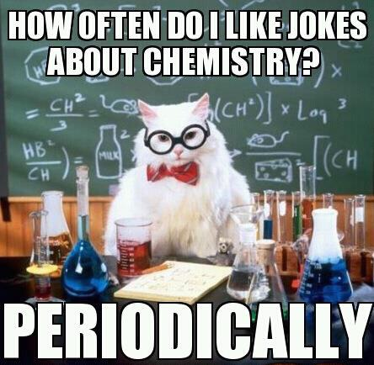

Slide 4
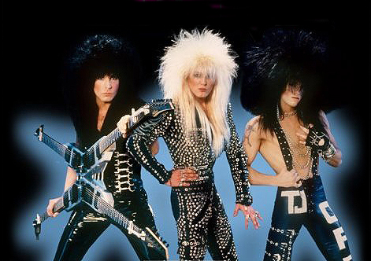
Properties of Metals
Found on the left side of the Periodic Table (except Hydrogen is not)
Metals are
good conductors of heat and electricity.
shiny.
ductile (can be stretched into thin wires).
malleable (can be pounded into thin sheets).
A chemical property of metal is its reaction with water which results in rust/corrosion.

Slide 5
Properties of Non-Metals
Found on the right side of the Periodic Table (Except for Hydrogen too)
Non-metals are
poor conductors of heat and electricity.
not ductile or malleable.
Solid non-metals are brittle and break easily.
They are dull.
Many non-metals are gases.
Sulfur

Slide 6
Properties of Metalloids
Located between Metals and Non-Metals on the PT
Metalloids (metal-like) have properties of both metals and non-metals.
They are
solids that can be shiny or dull.
ductile and malleable.
conduct heat and electricity better than non-metals but not as well as metals.
Silicon

Slide 8
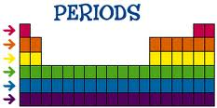
Periods
Each horizontal row of elements is called a period.
The elements in a period are not alike in properties.
Each element in the same period has the same number of energy levels (electron shells)
The first element in a period is always an extremely active solid. The last element in a period, is always an inactive gas.
As you travel right across a period, you increase the number of protons in the nucleus by 1

Slide 10
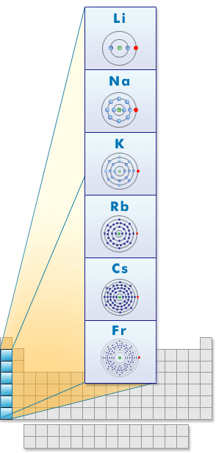
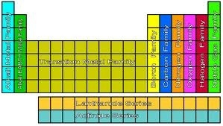
Families
Columns of elements are called groups or families.
Elements in each family have very similar properties.
All elements in a family have the same number of valence electrons.
As you move down a family, each new element has an extra energy level (electron shell)

Slide 11
Hydrogen
The hydrogen square sits atop Family I, but it is not a member of that family.
Hydrogen is in a class of its own. It is NOT in the next family.
It’s a gas at room temperature.
It has one electron in its one and only energy level.
Hydrogen only needs 2 electrons to fill up its valence shell.

Slide 12
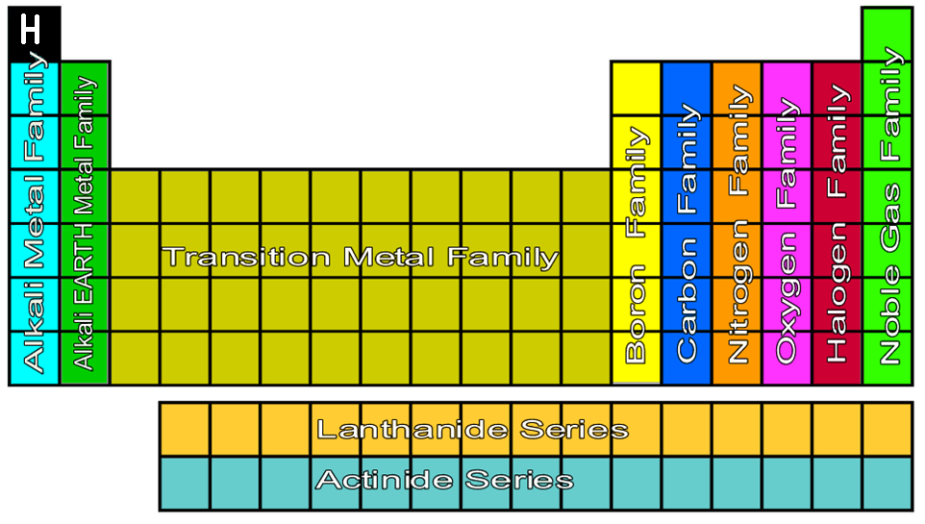
Periodic Table Family Names

Slide 13
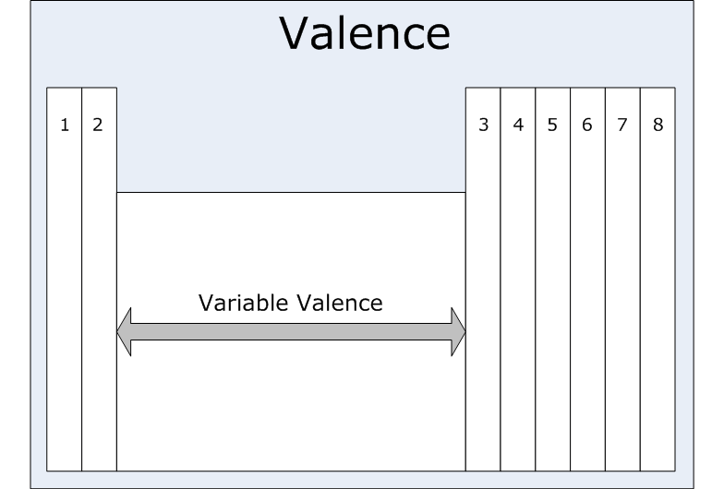
Valence Electrons
Each family has a set number of valence electrons.
This is why each element in one family reacts similarly.
1 = Alkali Metals
2 = Alkaline Earth Metals
3 = Boron Family
4 = Carbon Family
5 = Nitrogen Family
6 = Oxygen Family
7 = Halogen Family
8 = Noble Gas Family
Variable = Transition Metals
Each family also has a specific OXIDATION NUMBER
(More on Oxidation Numbers later)

Slide 14
Notes on Specific Families
Group 1: Alkali Metals
Hydrogen is not a member, it is a non-metal
1 electron in the outer shell
Often react with Halogen Family (7 valence electrons)
Very reactive, esp. with water
Group 2: Alkaline Earth Metals
2 electrons in the outer shell
Often reactive with Oxygen Family
(less reactive than Alkali metals though)

Slide 15
Notes on Specific Families
Group 3-12: Transition Metals (That block in the middle)
Good conductors of heat and electricity.
Used for wiring, tools, jewelry, decorative metalwork, etc…
Valence electrons (and thus Oxidation Numbers) can vary
For instance Cu can have 1, 2, 3, or 4 valence electrons depending on the version of Cu
Can bond with many elements in a variety of shapes.
Because of D block orbital (can hold up to 10 electrons)
Some transition metals are able to put up to 32 electrons in their second to last shell
Because of F block orbital (can hold up to 16 electrons)

Slide 16
Notes on Specific Families
Group 13: Boron Family
3 valence electrons
Most are metals → Boron is a metalloid
Group 14: Carbon Family
4 valence electrons
Contains metals, metalloids, and a non-metal
Group 15: Nitrogen Family
5 valence electrons
Contains metals, metalloids, and a non-metal

Slide 17
Notes on Specific Families
Group 16: Oxygen Family
6 valence electron
Contains metals, metalloids, and non-metals
Reactive: Generally with Alkali Earth Metals
Group 17: Halogen Gasses
7 valence electrons
All are non-metals
Very reactive
Often bonded with elements from Group 1

Slide 18
Notes on Specific Families
Group 18: Noble Gas Family
Exist as gases → All are non-metals
Not reactive with other elements because their valence shell is full
8 electrons in the outer shell = Full
Helium (He) has only 2 electrons in the outer shell to be full

Slide 19
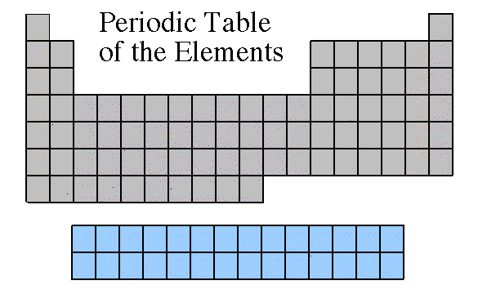
Rare Earth Metals
Lanthanide Series
Actinide Series
Some are Radioactive
The rare earths are silver, silvery-white, or gray metals.
Conduct electricity

Slide 21
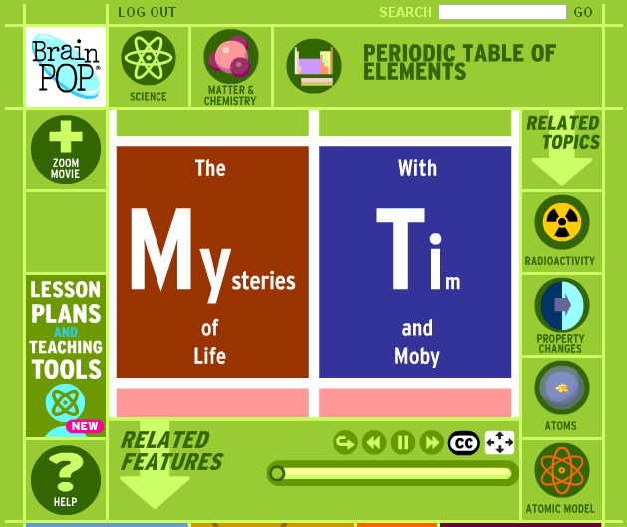
Recap!

