Slide 1
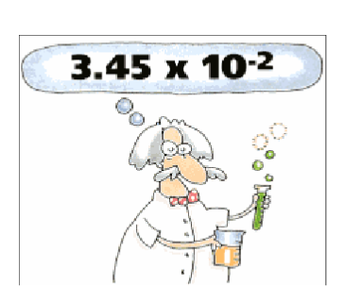
Converting Scientific Notation

Slide 2
Scientific Notation
Scientific Notation is a way of writing very large or very small numbers that are hard to express in decimal form.
A number is written in scientific notation if it is of the form c x 10^{n} Where c is between 1 and 10 and n is an integer.
Reminder: an integer is a positive, negative whole number including zero {….-3, -2, -1, 0, 1, 2, 3….}

Slide 3
Which of the following are written in proper scientific notation?
2.35 x 10⁵
2.1203 x 10¹⁰
5 x 10⁻⁹
45.9 x 10⁻⁶
3.214 x 10¹
10.3 x 10 ⁹
-78.3 x 10²³
6.09 x 10⁷
12 x 10⁻²²
-4.89 x 10⁸

Slide 4
Scientific Notation is used to write…. REALLY big numbers
Decimal Notation Scientific Notation
123,000,000,000.
45,000,000.
67,800,000,000,000.

Slide 5
Scientific Notation is used to write…. REALLY big numbers
Scientific Notation Decimal Notation
7.82 x 10 ³
3.04 x 10⁸
5 x 10⁴

Slide 6
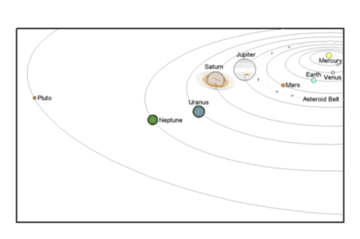
Here’s an example….
As the planets orbit the sun, the closest Pluto gets to Earth is approximately 2,700,000,000 miles.
Write that number in scientific notation.

Slide 7
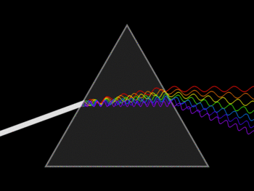
Here’s an example…
The speed of light in a vacuum is approximately 1.86 x 10⁵ miles per second.
Write this number in decimal notation.

Slide 8
Scientific Notation is used to write…. REALLY small numbers
Decimal Notation Scientific Notation
0.000000034
0.0000000005609
0.000000000064

Slide 9
Scientific Notation is used to write…. REALLY big numbers
Scientific Notation Decimal Notation
4.8 x 10⁻⁶
1.2 x 10⁻²
9 x 10⁻⁸

Slide 10
Here’s an example…
Human fingernails grow at a rate of about 0.00286 inches per day.
Write this number in scientific notation

Slide 11
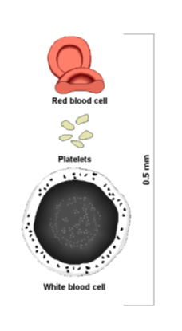
Here’s an example…
The thickness of a red blood cell is approximately 3.125 x 10⁻⁴ inches.
Write this number in decimal notation.

Slide 12
What about the exponents?
When do you write a negative exponent when converting to scientific notation?
When do you write a positive exponent when converting to scientific notation?

