Slide 1
The Nature of Science
(How Scientists Think)

Slide 2
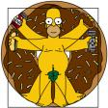
Why Science?
The goal of science is to understand the natural world we live in.

Slide 3
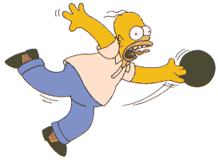
Why Hypothesize?
Scientist hypothesize in order to try to explain what they think will happen in a certain situation
Long-held assumptions should be questioned!

Slide 4
How do you achieve Scientific success?
Be creative: think outside the box!
Those “Creative” experiments end up being the best ones.

Slide 5
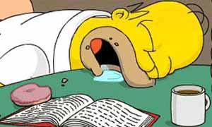
Persevere:
If at first you don’t succeed, try, try, try again!
If you did succeed, do it again to make sure it was correct in the first place.

Slide 6
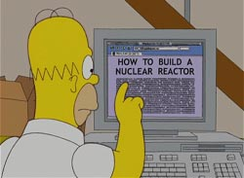
Question everything, but make your questions meaningful.
You must be able to create an EXPERIMENT based on that question

Slide 7
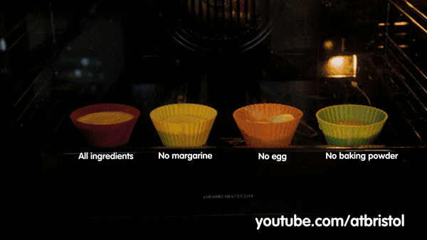
Experiments can be simple…
What are we testing here?

Slide 8
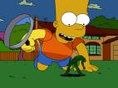
Scientific Inquiry
1. Observing / Come up with a question

Slide 9
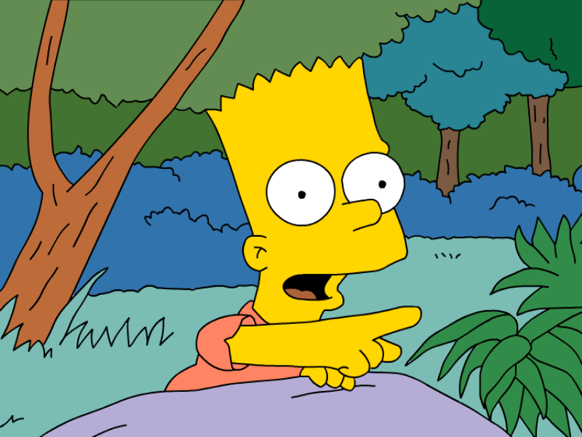
2. Asking questions / doing research

Slide 10
3. Forming a hypothesis
Hypothesis = educated guess BASED ON RESEARCH

Slide 11
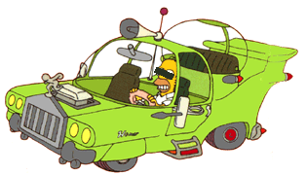
4. Testing the hypothesis (Performing the experiment)

Slide 12
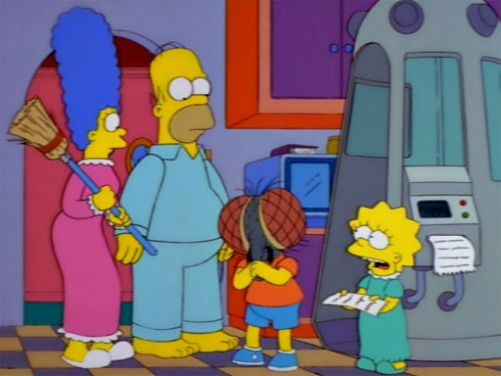
Within the Experiment
INDEPENDENT VARIABLE
The factor you change on purpose
Example: The size of the engine. The amount of fertilizer on plants.
There can only be ONE
independent variable
DEPENDENT VARIABLE
The result of what you changed
Example: The speed of the car. Growth rate of the plants.

Slide 13
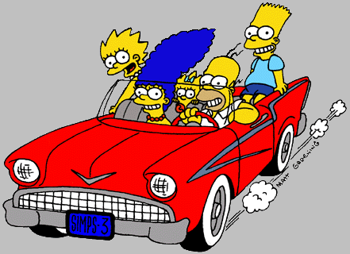
Within the Experiment
CONSTANTS
Factors (variables) you try to keep the same to make the comparison “fair”
Example: Test the speed of the car on the same track with the same car. Same amount of water & light for the plants.

Slide 14
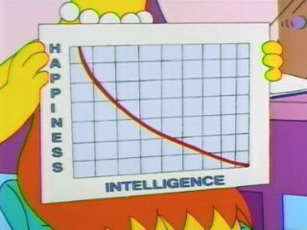
Within the Experiment
CONTROL GROUP
An experiment where one group receives no treatment. This group is used for comparison.
Example: Speed of a car that did not get a larger engine. Growth rate of a plant that did not get any fertilizer.
EXPERIMENTAL GROUP
The group that has had the independent variable added to it.
Example: The car with the bigger engine. Growth rate of a plant that did receive fertilizer.

Slide 15
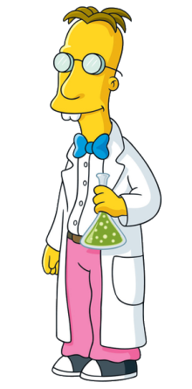
Within the Experiment
Scientists ALWAYS confirm results
REPEATED TRIALS
Repeat the experiment to increase
confidence in your results.
Average the results to reduce random error.
Take outliers into account.
More Data = Better Results!

Slide 16
5. Gathering data
More Data = Better Results!

Slide 17
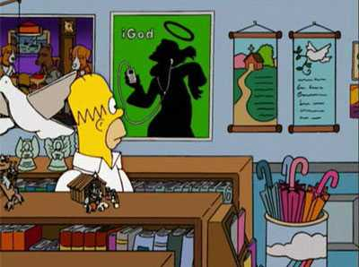
Evidence / Data
Your DATA is evidence
Evidence is what you observe NOT what you think is happening.
Evidence can be:
Measured
Observed using one’s
senses
But you have to be observant!

Slide 18
Data
QUANTITATIVE DATA
Results that can be measured and described with numbers.
Example: growth rate, speed, length, height, mass, volume
QUALITATIVE DATA
Results that are described in words. Results of our five senses.
Example: color, texture, “looks healthier”, “feels softer”, “smells burnt”

Slide 19
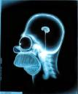
6. Conclusion
Restate your hypothesis, and state whether your data supported or rejected the hypothesis

Slide 20
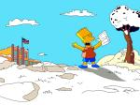
7. Sharing what has been learned
Communicate your data with colleagues
Publishing in journals
This is called PEER REVIEW
You can’t trust the findings
unless it has been peer
reviewed

Slide 21
Science is always tested
Once a scientific idea becomes widely accepted, it will CONTINUE to be tested and experimented on.
Every time an experiment is run, new information is learned

