Slide 1
Gas Laws

Slide 2
Gas Laws
As you recall, gasses have no fixed shape or volume
However, the relationship between the pressure, volume, and temperature of a gas holds true for all gases.
  Because gases behave in a similar way thru a wide variety of conditions because they all have molecules which are widely spaced
Because of this, we have laws that can explain the way gasses will act under certain conditions

Slide 3
Gas Laws
So, we have 3 GAS LAWS:
  Boyle’s Law
  Charle’s Law
  Gay-Lussac’s Law
For each law, one condition is held constant, while the other two conditions will change
  Conditions of Temp, Pressure, Volume

Slide 4
Gas Laws: The Equation
P₁V₁ = P₂V₂
T₁ T₂
Using this equation, you can solve for temperature, pressure, and volume.
The thing that is being held constant in that problem is just ignored from the equation
  We will look at that more later.

Slide 5
Gas Laws: Background Info / Units
Standards that you need to understand for all work with gas laws: (I will give you these on the test)
TEMPERATURE:
  Kelvin will always be used in Gas Laws
PRESSURE:
  Caused by atoms colliding with container
  1 atm
VOLUME:
  L (at least one of them will be easy to remember)

Slide 6
What is atmospheric pressure?
Each particle of air held in place by gravity collides with and exerts a force against you and everything around you creating air pressure.
  The closer you are to sea level, the more pressure acting on you.
  The higher the altitude, the
  less gravity, and therefore
  the less pressure acting on you.

Slide 7
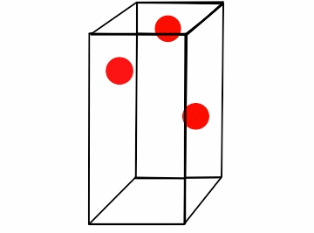
Boyles’ Law
We know that P₁V₁ = P₂V₂
T₁ T₂
If the temperature remains constant, the volume and pressure vary inversely
  Simply if Pressure ↑, then Volume↓
    And vice versa
If temperature is constant, ignore it in the formula
  P₁ V₁ = P₂ V₂

Slide 8
Boyles’ Law
REAL WORLD EXAMPLES
A syringe: as you are trying to take blood and pull back on the plunger, the air volume in the syringe increases, decreasing pressure. The decrease in pressure causes blood to enter into the syringe
Air bubbles increase in size as they work they travel from deep water to shallow water.
Your ears popping in high altitude situations (in an airplane).
Deep sea creatures dying when they are brought to the surface (and scuba divers getting the bends)
  MARSHMALLOW DEMO!!!

Slide 9
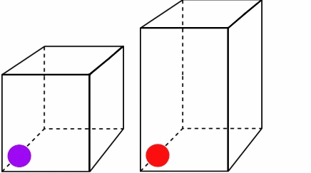
Charles’ Law
We know that P₁V₁ = P₂V₂
T₁ T₂
If the pressure remains constant, the volume and temperature vary directly
  Simply if Temp ↑, then Volume ↑
    And vice versa
If pressure is constant, ignore it in the formula
  V₁ V₂
  T₁ T₂
=

Slide 10
Charles’ Law
REAL WORLD EXAMPLES
Your car tires will “deflate” on the first very cold morning. It doesn’t lose air, but the air is taking up less space.
A basketball that would bounce in the summer does not bounce well anymore in the winter.
  Hot air balloons float because when air is heated, it takes up more volume. More volume with the same amount of air means it is less dense than the air around the hot air balloon.
  DEMOS!!!
  - Balloon on a Bottle Demo!!!!
  - Inverted Beaker in Boiling water, then turn off hot plate…

Slide 11
Gay-Lussac’s Law
We know that P₁V₁ = P₂V₂
T₁ T₂
If the volume remains constant, the temperature and pressure vary directly
  Simply if Pressure ↑, then Temp ↑
    And vice versa
If volume is constant, ignore it in the formula
  P₁ P₂
  T₁ T₂
=

Slide 12
Gay-Lussac’s Law
REAL WORLD EXAMPLES
A cannonball shooting out of a cannon. Cannon barrell shape (volume) is constant. When gun powder is ignited, the temperature rises sharply and substantially. This increases pressure until the cannonball is launched from the cannon.
An aerosol can exploding when it is close to flames. The can stays the same volume, so as temp increases, pressure increases, until BOOM!
  A propane tank exposed to VERY hot temperatures would do the same thing.
  DEMOS: Egg in a flask, candle in a beaker, can crush, water fountain in an erlenmeyer flask

Slide 13

Gay-Lussac’s Law
Popcorn popping…

Slide 14
Solving Gas Law Problems
Figure out which law you are dealing with
  The law you are dealing with will dictate which variable you ignore
Write out your known values and your formula
Insert your known values into your formula
Solve for the variable
  Include Units!

Slide 15
Recap
  And how do I remember which law keeps which variable constant?
Big Tigers Can Play Golf Violently
  Boyles’ → Temp is Constant
  Charles → Pressure is Constant
  Gay-Lussac’s → Volume is Constant
  Remember to think about your popsicle stick!

