Slide 1
Composition of Matter

Slide 2
What is Matter?
Anything that has mass and takes up space
Two categories:
Substances
Mixtures

Slide 3
What is Matter?
Anything that has mass and takes up space
Two categories:
Substances
Mixtures

Slide 4
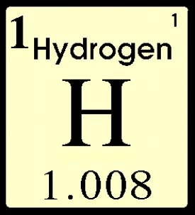
Substances
Two Categories:
Element
Compound

Slide 5
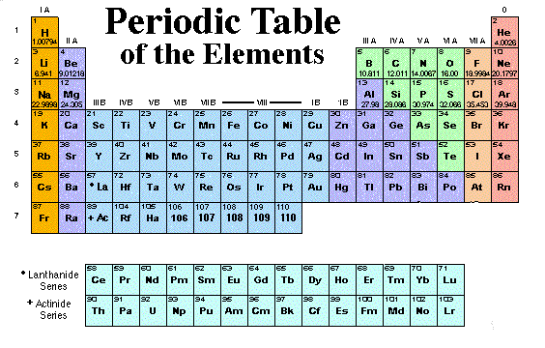
Elements
Elements are pure substances composed of only one type of atom
There are 118 known elements
92 of them occur
naturally
It is only an element
if it is found on the
Periodic Table

Slide 6
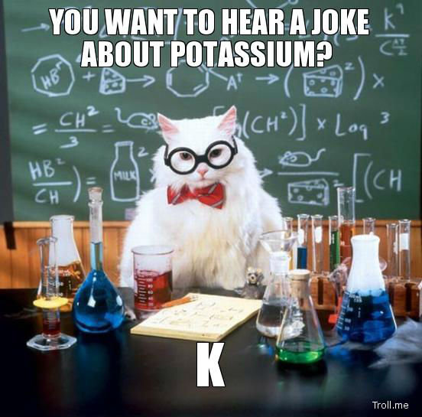
Elements: How to Write Them
Element symbols are written with the 1st letter capitol, and the 2nd lower case
Ex:
Hydrogen = H
Carbon = C
Oxygen = O
Calcium = Ca
Neon = Ne

Slide 7
Atoms
An atom is the smallest unit of an element that is still that element
All atoms of one element are alike
For instance, Au is pure gold. Every atom in Au will be the same.

Slide 8
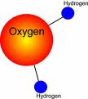
Compounds
Two or more elements bonded together in a fixed proportion
They are the same every time
CO₂, H₂O, NaCl
C₆H₁₂O₆, C₈H₁₀N₄O_{2,} C₂H₅OH
If you see 2 different elements written together with no spaces, it is a compound
Physical processes CANNOT separate compounds

Slide 9
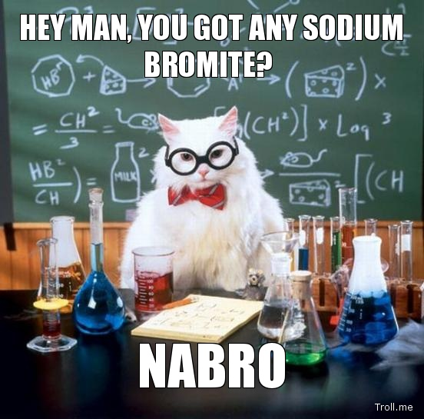
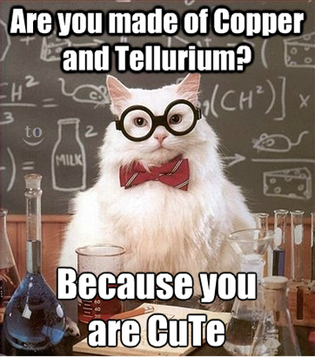
Compounds
If you see 2 different elements written together with no spaces, it is a compound
Which of the two pictures is written correctly?

Slide 10
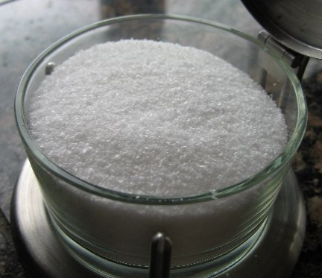
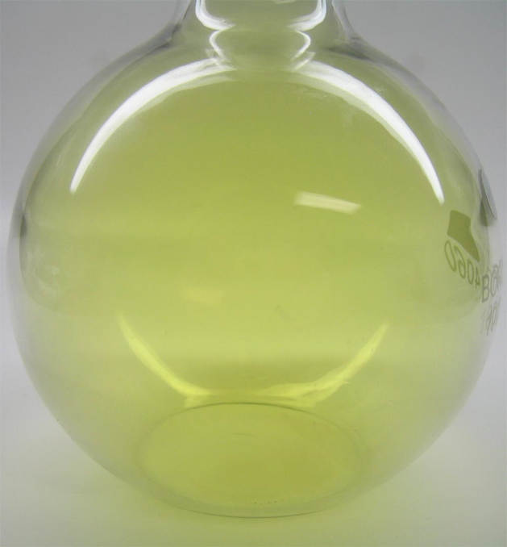
Compounds
Compounds have different appearance (and properties) than the elements that make them up
NaCl (table salt) is made of Na (sodium) and Cl (chlorine)
Table Salt has a different appearance than the elements that make them up
Compounds are always molecules, but molecules are not always compounds

Slide 11
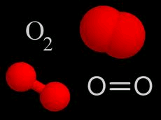
Molecule
Two or more of the same atoms bonded in a fixed proportion
These atoms do not need to be DIFFERENT atoms
H-H is a molecule. So is O=O
CO₂ and H₂O are also molecules
Molecules are the smallest form of a compound that can exist and still have the same properties of the compound

Slide 12
What is Matter?
Anything that has mass and takes up space
Two categories:
Substances
Mixtures

Slide 13
Mixtures
Contain more than one type of matter that IS NOT chemically bonded together
Can be separated physically
2 Types:
Homogeneous
Heterogeneous

Slide 14
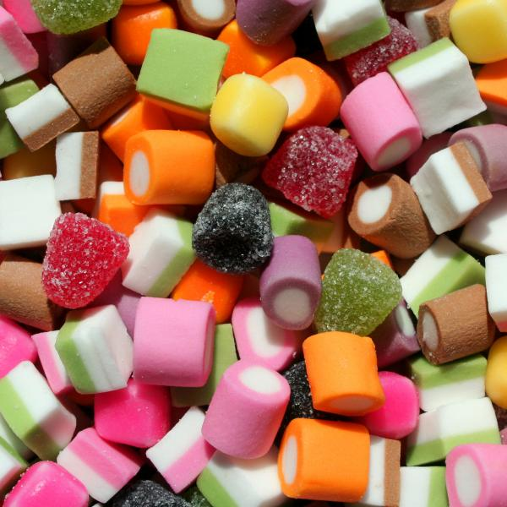
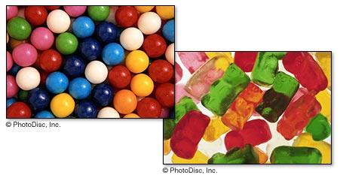
Heterogeneous Mixtures
Matter is not made up of same proportions
Different parts have easily distinguishable materials
Ex: cereal, trail mix, cookie dough ice cream, kit-kat bar
CAN be physically separated

Slide 15
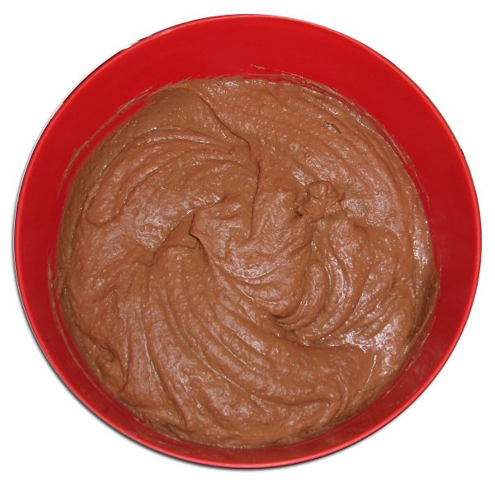
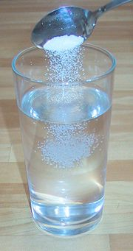
Homogeneous Mixtures
Matter is same throughout; perfectly evenly blended
Ex: soda, air, chocolate ice cream, salt water, kool-aid
Also called a solution
CAN be physically separated

Slide 16
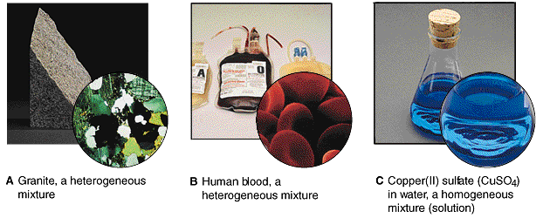
Homogeneous vs Heterogenous
Examples:

Slide 17
Matter
Mixtures
Substances
Homogeneous
Heterogeneous
Elements
Compounds

Slide 18
Page 279 in textbook

