Slide 1
Isotopes and Ions

Slide 2
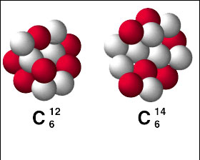
Isotopes
Isotopes: atoms of the same element that have different numbers of neutrons
Two isotopes of an element will have the same atomic number, but different mass numbers (and atomic masses)
CARBON (above right)
What is the mass number to the left?
What is the mass number to the right?
What is the atomic number to the left?
What is the atomic number to the right?

Slide 3
Isotope Example
So, which of the following represent isotopes of the same element?
#1 #2 #3 #4
²³⁴ _{X}²³⁴ _{X}²³⁵ _{X}²³⁸ _{X}
⁹²⁹³⁹²⁹²
Which element are these isotopes of?

Slide 4
Isotope Notation
Write the symbol with the mass number on top and the atomic number on the bottom
Example:

Slide 5
Isotope Example
Naturally occurring carbon consists of three isotopes, ¹⁴N, ¹⁵N, and ¹⁶N. State the number of protons, neutrons, and electrons in each of these carbon atoms.
¹⁴N ¹⁵N ¹⁶N
7 7 7
#P _______ _______ _______
#N _______ _______ _______
#E _______ _______ _______

Slide 6
Ions
IONS are charged atoms (or groups of atoms) that have a positive or negative charge.
Ions differ in the number of electrons
For Neutral Atoms :
Number of electrons = number of protons
For Ions :
protons the same, electrons are different
Either lost or gained electrons
Examples:
Neutral Atom: Na, Ca, I, O
Ion: Na⁺ Ca⁺² I⁻ O⁻²

Slide 7
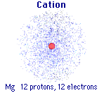
IONS
Taking away an electron from an atom gives a positive charge because there are now more protons
Called a CATION
So if the Mg atom to the right
loses 2 electrons, it becomes Mg²⁺

Slide 8
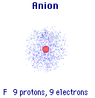
IONS
Adding an electron to an atom gives a negative charge because there are now more electrons
Called an ANION
So if the F atom to the right
gains 1 electron, it becomes F⁻

Slide 9
Ion Practice
State the number of protons, neutrons, and electrons in each of these ions.
³⁹ K⁺¹⁶O ⁻²⁴¹Ca ⁺²
19 8 20
#p⁺ ______ ______ _______
#nº ______ ______ _______
#e⁻ ______ ______ _______

Slide 10
