Slide 1
Electron Arrangement

Slide 2
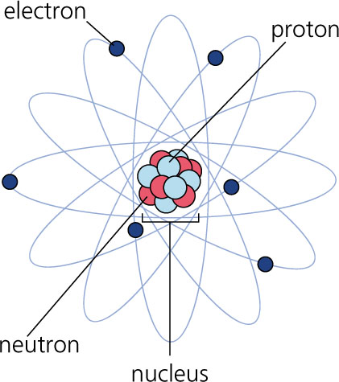
Energy Levels
Electrons that are closer to nucleus have lower energy
Further away = Higher energy
So the further away from the nucleus an electron is, the more energy it has
The electron cloud is organized into shells.
Each shell has a max. number of electrons it can hold

Slide 3
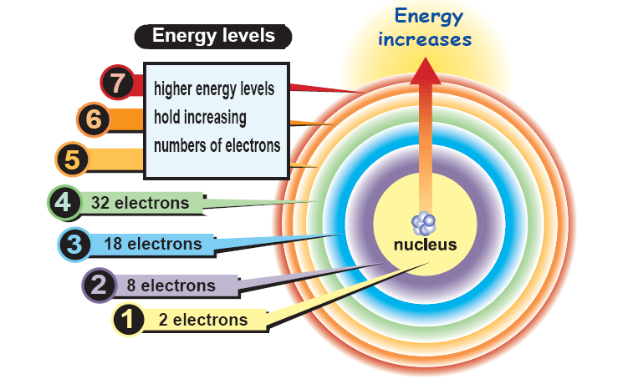
# of Electrons in Each Energy Level
1st Level = 2 electrons
2nd = 8 e-
3rd = 18 e-
4th = 32 e-
Electrons must occupy the lowest energy level or orbital first

Slide 4
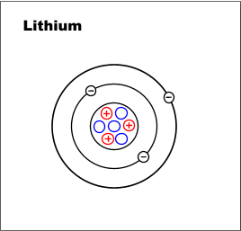
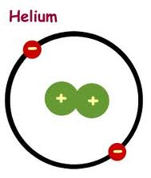
Bohr Diagrams
Bohr Diagrams show each of the energy levels of the atom
Show every electron that the atom has orbiting around it.
These electrons are organized into the different shells or orbital levels
1st level - 2 electrons
2nd level - 8 electrons
3rd level - 18 electrons
Examples:

Slide 5
Bohr Diagrams: You Try
Draw me the Bohr Diagram of each of the following:
H B
F Si

Slide 6
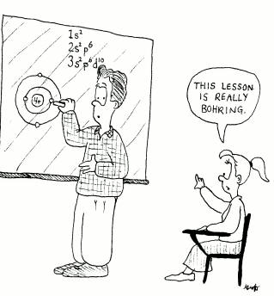

Slide 7
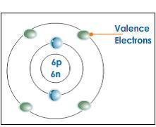
Valence Electrons
Electrons in outermost shell = valenceelectrons
Determine the properties of the element
Will it bond with other elements? Which ones? Valence electrons tell us the answers.

Slide 8
Each column (except for the transition metals) has a set number of valence electrons

Slide 9
YOU-TRY!
Use the group number above the column to determine the number of valence electrons.
Sodium – (Na)
Boron – (B)
Chlorine – (Cl)
Neon – (Ne)
1 valence electrons
3 valence electrons
7 valence electrons
8 valence electrons

Slide 10
Lewis Dot Diagrams
Uses the symbol of the element and dots to represent VALENCE electrons

Slide 11
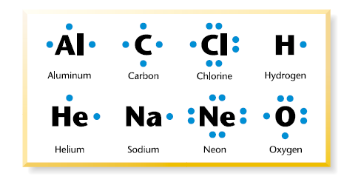
Lewis Dot: How To…
Write the symbol of the element
Figure out how many valence electrons it has
Each side of the symbol can only hold 2 electrons
1 dot = 1 electron
Each side must get one electron before any side can get 2
Max Number = 8 dots for 8 electrons
(You can’t have more than 8 electrons on the outside row)

Slide 12
Electron Arrangement
Electron Configuration and Orbital Diagram

Slide 13
Remember…
Electrons must occupy the lowest energy level or orbital first
1st Level = 2 electrons
2nd = 8 e-
3rd = 18 e-
4th = 32 e-

Slide 14
But what is an orbital?
Suppose you had a single hydrogen atom
You plot where the electron is at any given time
2 seconds later, you again plot where the electron is
You never know the path that the electron took to get from A to B
You continue doing this every 2 seconds for an hour
If after that hour, you graphed each of these plotted points, you would have a picture that looks like the one above.
An orbital basically means that the electron can be assumed to be found within that general location 99% of the time
Notice that it is not a specific ORBIT, but instead an ORBITAL

Slide 15
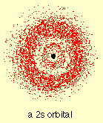
But what is an orbital?
The same basic idea occurs for the second orbital (or ring of electrons) that will form around the nucleus.
Notice the gap between the two orbitals
An Orbital is the general region
where an electron is very likely
to be found.
Electrons DO NOT orbit
An orbit is a predictable elliptical
path that an object follows

Slide 16
Electron Configuration
The purpose of the Electron Configuration is to identify basically where each of the electrons are located around an atom
Each energy level (2, 8, 18, 32) contains the different sub-orbitals
There are 4 types of sub-orbitals
S, P, D, F
S (holds 2 e-) D (holds 10 e-)
P (holds 6 e-) F (holds 14 e-)

Slide 17
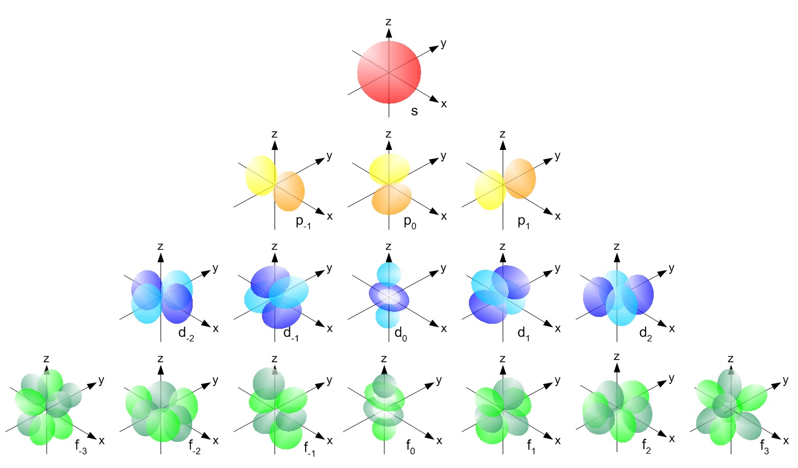
Electron Energy Levels
Each type of suborbital has a different shape and gets slightly more complicated
The reason for these shapes is to get as many electrons as possible, as close to the nucleus as possible, while keeping the
electrons separated
from each other

Slide 18
Electron Configuration
So the purpose is to tell me how many electrons are in each orbital

Slide 19
Electron Configuration
So the purpose is to tell me how many electrons are in each orbital
So for instance:
H = 1s1 (has 1 electron in the 1s orbital)
He = 1s2 (has 2 electrons in the 1s orbital)
Li = 1s² 2s1 (has 2 electrons in the 1s orbital and 1 electron in the 2s orbital)
B = 1s² 2s² 2p¹
All the way up to:
Ar = 1s² 2s² 2p⁶ 3s² 3p⁶

Slide 20
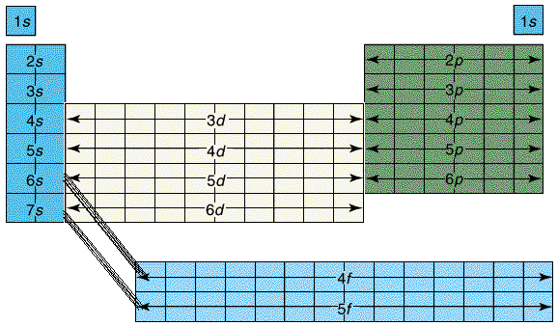
Orbitals and the Periodic Table
This is the part you have to know!!

Slide 21
Electron Energy Levels
The first Trick….The periodic table itself….
This shows the ENERGY LEVEL and TYPE OF ORBITAL

Slide 22
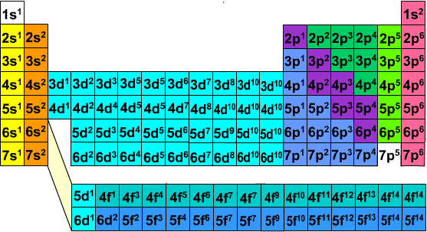
Electron Energy Levels
This shows the ENERGY LEVEL and TYPE OF ORBITAL
AND the NUMBER OF ELECTRONS in that type of orbital at that energy level

Slide 23
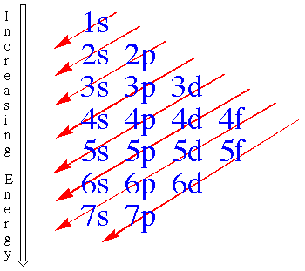
Electron Energy Levels
Or a second trick that you will learn in chemistry…

Slide 24
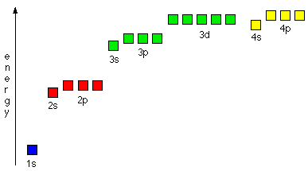
Electron Energy Levels
Or a third Trick….The energy level table
(PS: This is given to you on your test)

Slide 25
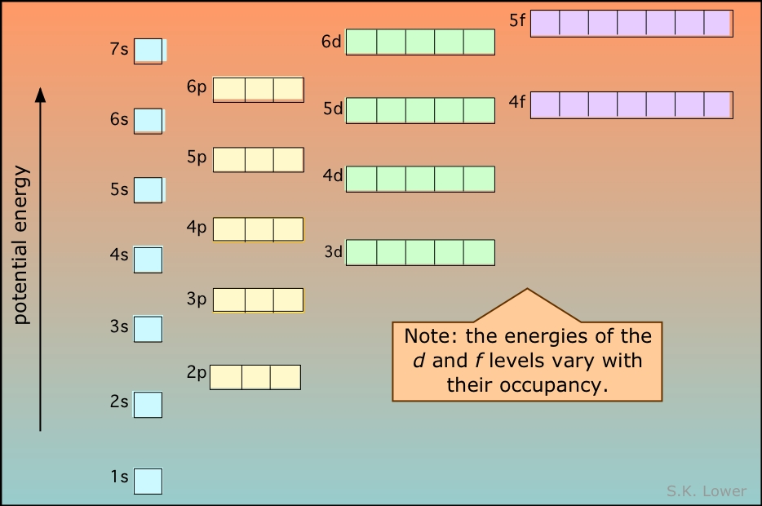
Electron Energy Levels
h

Slide 26
Electron Energy Levels
Try out a few:
Be =
O =
P =
1s² 2s²
1s² 2s² 2p⁴
1s² 2s² 2p⁶ 3s² 3p³

Slide 27
Orbital Diagrams / Electron Spin
Remember electrons have a negative charge
And you recall that Like Objects Repel
Meaning that two electrons want to avoid each other as much as possible.
So how do they do that?
They can do that because electrons spin
And two electrons within the same orbital will spin in opposite directions

Slide 28
Orbital Diagrams
Basically, for each new orbital (or energy level) you need to fill with arrows that indicate the spin
There are two options of arrows: up or down
Rules:
Each orbital must be filled before you move onto the next orbital
Within an orbital, you must fill ALL of the up arrows before you fill the down arrows
These diagrams are called Orbital Diagrams
The number of arrows you have will equal the number of electrons in that atom.

Slide 29
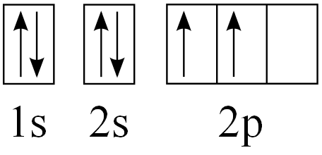
Orbital Diagrams
Remember:
Each S orbital has only 2 electrons, so it just gets one up arrow and one down arrow.
Each P orbital has 6 electrons, so you place the 3 up arrows before you go back and pair any of the up arrows with down arrows.
Example:
Hydrogen Helium Carbon

Slide 30
Orbital Diagrams: Recap
Basically, each orbital gets filled with all of the electrons before you can move up to the next orbital
1s, then 2s, then 2p, then 3s
You must put in all your up arrows for that orbital before you can put in any down arrows
If you have any up arrows with no down arrow partner, it is considered an unpaired electron

