Slide 1
CHEMICAL REACTIONS CONTINUED… ENERGY!
Endothermic, Exothermic, Catalysts, Enzymes, etc.

Slide 2
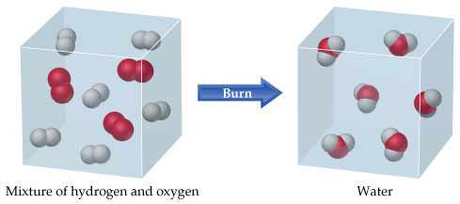
Chemical Changes
The substances present at the beginning of the reaction are changed into something new.
Essentially, you are going to break bonds, rearrange those atoms, and form new bonds.

Slide 3
Energy in Chemical Reactions
All chemical reactions involve energy
Every time a bond is made or broken, energy is used.
Breaking bonds releases energy
Forming bonds stores energy

Slide 4
Energy in Chemical Reactions
Chemical energy is stored inside chemical bonds (the stronger the bond, the harder it is to start the chemical reaction)
More on this in Unit 7
Energy is never created or destroyed.
So the energy within the reactants and activation must be the same as the energy within the products

Slide 5
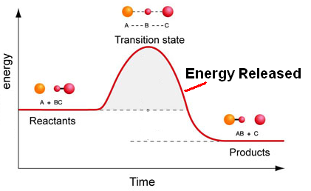
Heat Changes in Chem Reactions
Exothermic reaction:
produce energy and the temperature rises (so they RELEASE heat!)
Examples: Hand warmer, fire, glow sticks, etc.

Slide 6
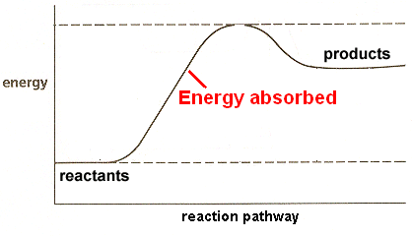
Heat Changes in Chem Reactions
Endothermic reaction:
require a lot of energy so the temp drops (and it ABSORBS heat!)
Examples: cold pack, baking bread, cooking an egg

Slide 7
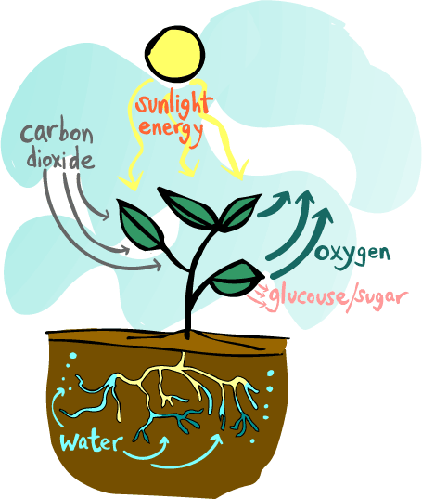
Photosynthesis: Reaction Discussion
Endothermic reaction:
Reactants: Products:
Carbon Dioxide Oxygen
Water Sugar (glucose)
Energy from the sun is being
transformed into chemical energy,
which is being stored in sugars

Slide 8
Speeding up Reactions
The following increase the rate of reactions BECAUSE they increase collisions!
Increasing temperature
Increasing surface area
Increasing the concentration of reactants
Increasing the pressure
And CATALYSTS!

Slide 9
Catalysts!
A catalyst is a substance that speeds up a reaction
It does this by lowering the activation energy of a chemical reaction.
A catalyst is never changed, or never used up.
Think of it as a tool (like a screwdriver)
Each catalyst has ONE SPECIFIC JOB

Slide 10
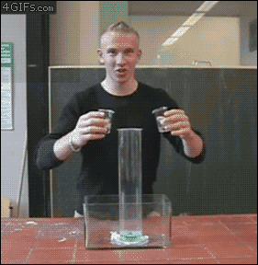
Catalysts!
DEMO: 30% hydrogen peroxide + Dish Soap
With potassium iodide (KI) catalyst

Slide 11
Elephant Toothpaste!
H₂O₂→ H₂O + O₂
Potassium Iodide is the catalyst
The iodine (from KI) is not used up. How can you tell?
The orange/yellow coloring
Endothermic or exothermic? Explain why.
Exothermic. Heat is released.
So much O₂ is produced from the small amount of that it has to escape the graduated cylinder quickly
As it escapes, the O₂ forms bubbles in the soap, and turns the soap into foam.

Slide 12
Enzymes!
Enzymes are merely catalysts that work in the body.
Just like catalysts, each enzyme has one specific job
DEMO – Cracker Challenge!
Enzyme | Substrate | Role of Enzyme
Amylase | Starch | Break down starch into smaller sugar molecules (starch breaks down into maltose)
Cellulase | Cellulose | Break down long cellulose strands into smaller sugar molecules (cellulose breaks down into glucose)
DNA polymerase | Nucleic acid | Builds DNA chains in cell nuclei
Lipase | Fat (lipids) | Break down fat into small molecules
Protease | Protein | Break down proteins into smaller amino acids

Slide 13
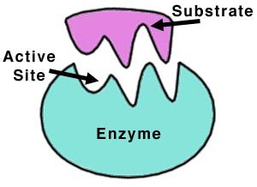
Enzyme and Substrate
Substrate: The reactant an enzyme acts upon.
Essentially, the enzyme and the substrate are like a LOCK AND KEY.

