Slide 1
Types of Reactions

Slide 2
Types of Reactions
Addition (Synthesis)
Decomposition
Single Displacement (Replacement)
Double Displacement (Replacement)
Acid-Base Reaction
Combustion

Slide 3
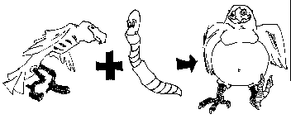
Addition (Synthesis)
Two or more substances combine to form a new compound
A + B → AB
Fe + O₂ → Fe₂O₃

Slide 4
Addition (Synthesis)

Slide 5
Decomposition
Compounds are broken down into two or more smaller compounds
AB → A + B
SiCl₄ → Si + 2Cl₂

Slide 6
Decomposition

Slide 7
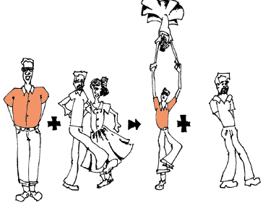
Single Displacement
One element replaces another in a compound
AX + B → BX + A
Ca + 2 HCl → CaCl₂ + H₂

Slide 8
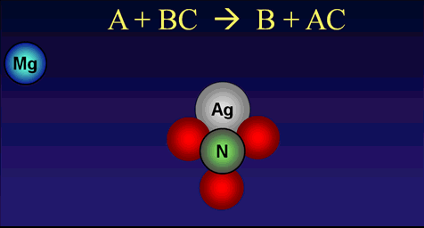
Single Displacement

Slide 9
Single Displacement
Iron + Copper Sulfate: The iron replaces the copper in the solution, turning copper sulfate into iron sulfate (FeSO4). Pure copper collects on the iron.

Slide 10
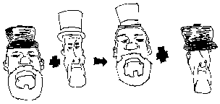
Double Displacement
Ions switch places; two elements switch places
AB + CD → AD + CB
AgNO₃ + NaCl → AgCl + NaNO₃

Slide 11
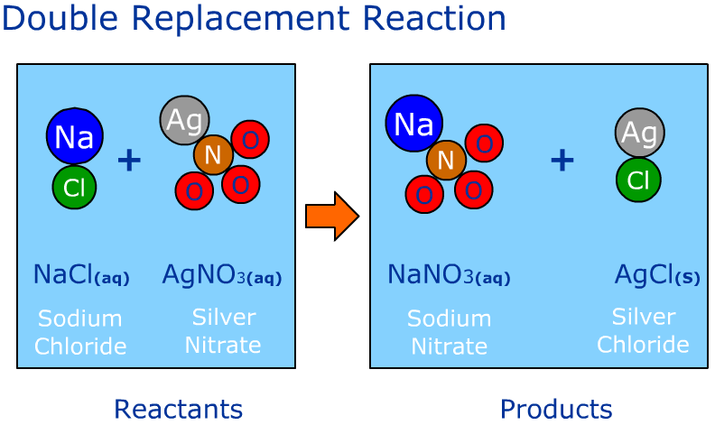
Double Displacement
http://www.mcgrawhill.ca/school/applets/sf10/unit1/dreplacement.swf

Slide 12
Acid-Base Reaction
Double Displacement reaction that ends in H₂O and a salt
AB + CD → Salt + H₂O
HCl + NaOH → NaCl + H₂O
SALT WATER
*This is for an acid and a base that are equal strength only.

Slide 13
Combustion
Carbon compound combines with oxygen to release carbon dioxide and water and energy
Carbon cmpd + O₂ →
CO₂ + H₂0 + energy!
C₂H₆ + 7 O₂ → 4 CO₂ + 6 H₂0
But don’t forget that ENERY is a product too (heat, light, etc)…

Slide 14
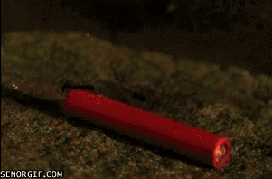
Combustion
Dynamite combusting…

Slide 15
Let’s Recap
Addition
- End with only 1 compound
Decomposition
– Start with only 1 compound
Single Displacement
- Each side has a single element and a compound
Double Displacement
- Each side has 2 compounds
Acid-Base Reaction
- Products will always be H₂O and a salt of some form
Combustion
- Products will always be CO₂ + H₂O and ENERGY

