Slide 1
Motion
How fast is fast?

Slide 2
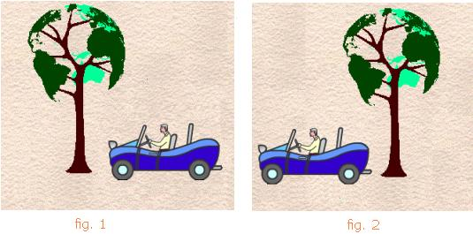
Motion
Motion – change in position relative to a reference point.
Frame of reference – a system used to identify the precise location of an object

Slide 3
Distance vs. Displacement
Distance: How far an
object has moved.
SI unit = meter
“Total steps taken”
Total Displacement:
The distance and direction
of an object’s change in position
from the starting point
Displacement includes direction
“How far are we from where we started?”

Slide 4
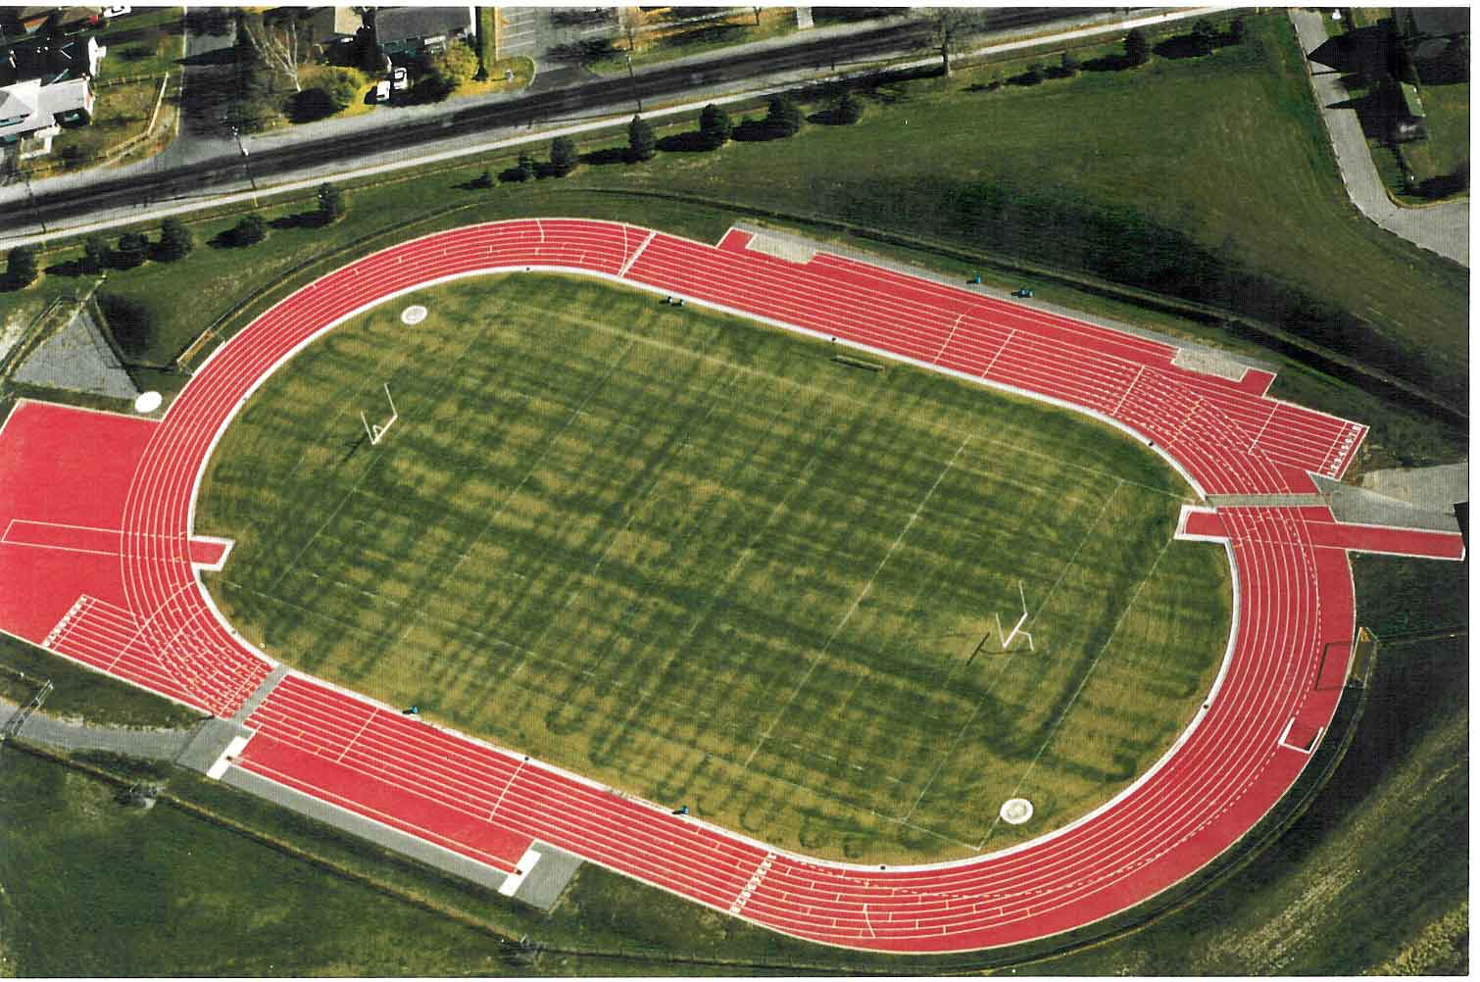
Distance vs. Displacement

Slide 5
Wait… there is direction?!?!?
Scalar – quantity that is described by only a magnitude (a number)
Ex: 10m/s, 8m, 38degC, 27 watts
Vector – quantity that is described by both magnitude AND direction
Ex: 10m/s south, 8m upward, 9.8m/s² to the ground

Slide 6
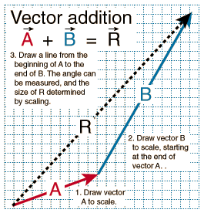
Vectors
Distance is a Scalar(Just a number)
Displacement is a Vector(A Number and A Direction)
The image to the right shows
vector addition (multiple vectors).
We will deal with this in a bit.
The arrow length indicates
the magnitude of velocity
Vector Video!!!

Slide 7
Vector Terms
Part without arrow is “head” of vector
Part with arrow is “tail” of vector
When adding vectors, we always put them “head-to-tail” for as many vectors as we have
The “resultant vector” is the result of your vector addition, and it is ALWAYS drawn from the head of the first vector to the tail of the last vector

Slide 8
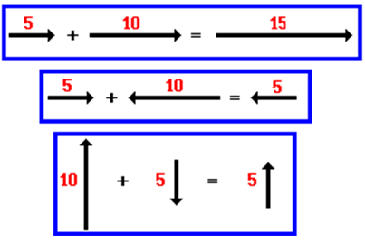
Vector Addition
Because velocities (and vectors) include magnitude AND direction, combining two vectors depends on their directions and signs
Can occur in a single plane
Can occur perpendicular (at a right angle) to each other

Slide 9
Vector Addition continued (HONORS)
For vectors at right angles to each other, we use the Pythagorean theorem to find the resultant vector:
a² + b² = r²
“a” is magnitude of first vector
“b” is magnitude of second vector
“r” is magnitude of resultant vector
Direction of resultant vector comes from looking at the directions of “a” and “b”

Slide 10
Vector Addition Practice
Find the resultant vector when adding 5m north and 22m south.
+ = 17m south

Slide 11
Vector Addn Practice (HONORS)
Find the resultant vector when adding 35km south and 50km west.
+ =
a² + b² = r²
(35km)² + (50km)² = r²
r = 61.03 SOUTHWEST (south + west)

Slide 12
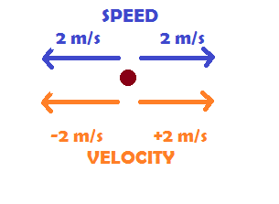
Scalar vs Vector
Scalar (Just a number)
Distance
Speed
Vector (A Number and A Direction)
Displacement
Velocity

Slide 13
Speed and Velocity
Speed – how fast an object is moving
Does NOT include a direction
Velocity – rate at which an object changes it’s position
Basically, it is how long it takes an object to get from point A to point B
Includes both magnitude AND direction

Slide 14
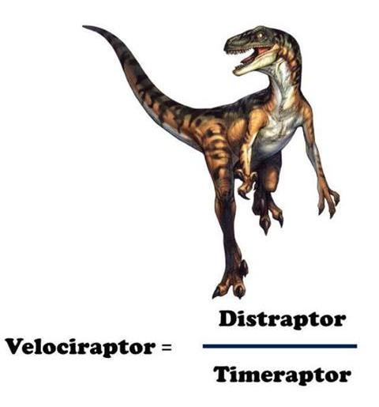
Speed vs. Velocity
Speed – distance / time
Simply the magnitude of Velocity
S = d/t
Velocity – displacement / time
Speed WITH a direction
V = d/t
SI Units for:
Distance+Displacement = meters (m)
Time = seconds (s)
Speed+Velocity = meters/second (m/s)

Slide 15
More Velocity
Notice speed has no + or –
Velocity however, can be + or – magnitudes. That indicates a direction
A vector is a quantity with a direction
Positive velocity is right and up
Negative velocity is left and down

Slide 16
Two Kinds of Velocity
We will almost ALWAYS calculate average velocity
Average Velocity: total distance traveled divided by the total time
Ex: velocity on trip from Chas to Orlando
Instantaneous Velocity: velocity at a specific instant
Ex: speedometer

Slide 17
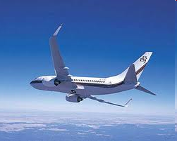
Practice
What is the speed of a commercial jet which travels from New York City to Los Angeles (4800 km) in 6 hours?
What would the velocity be?
800 km/hr WEST

Slide 18
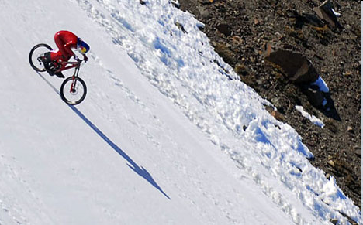
More Practice
What is the speed of a bike that travels 355 meters in 103.7 seconds?
What would the velocity be?
3.42 m/s DOWNHILL

Slide 19
And Even More Practice!
A train travels 100 km/hr for 2 hours. What distance has it traveled?
S = d/t
100km/hr = d / 2hrs
200km = d

