Slide 1
Position vs Time Graphs
Pictures say 1000 words…

Slide 2
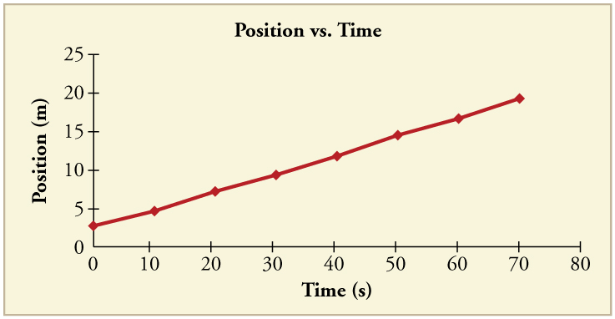
Position vs Time Graphs
Motion can be studied using a position vs. time graph.
POSITION (or DISPLACEMENT) on the vertical axis
TIME on the horizontal axis.
The SLOPE of the line indicates the VELOCITY

Slide 3
Calculating Slope
Slope (which is the velocity), can be calculated by finding the change in position over the change in time
(y₂ – y₁) (x₂ – x₁)
OR RISE over RUN

Slide 4
Calculating Slope
So let’s try it:

Slide 5
Calculating Slope
1) Choose 2 points to start and end at.
y₂ = y₁ =
x₂ = x₁ =
2) Calculate the change between the points.
Difference in Position (y) =
Difference in Time (x) =
3) Calculate
Slope = Position / Time
(y₂ – y₁) / (x₂ – x₁)
AND REMEMBER, SLOPE = VELOCITY

Slide 6
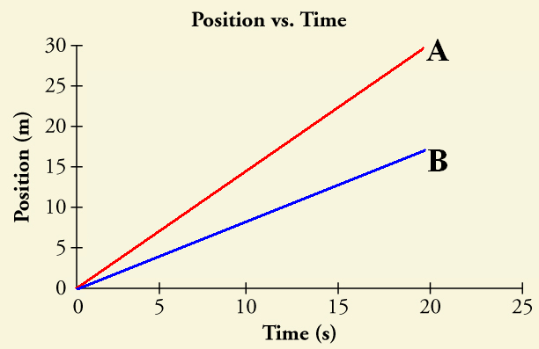
Different Slopes mean…
POSITIVE slope indicates a POSITIVE velocity
Positive velocity means it is moving forward
The greater the slope, the greater the velocity
The less the slope, the smaller the velocity
Which has a greater
velocity?
A – It has a greater
slope and is steeper.

Slide 7
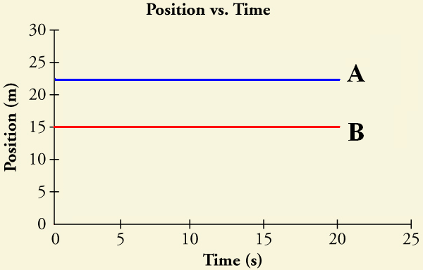
Different Slopes mean…
ZERO slope indicates a ZERO velocity
Zero slope means that the line is horizontal
Which has a greater
velocity?
They are both
the same. Neither
is moving.

Slide 8
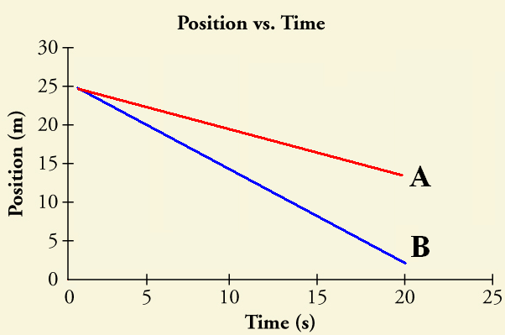
Different Slopes mean…
NEGATIVE slope indicates a NEGATIVE velocity
Negative velocity means that the object is traveling in the negative direction.
Which has a greater
negative velocity?
B – It has a greater
slope, therefore a
greater neg velocity

Slide 9
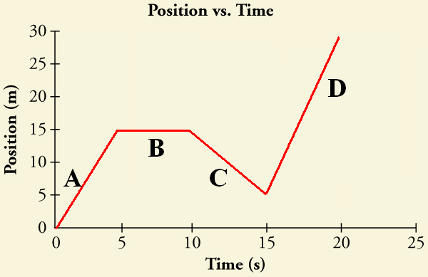
Put it all together…
So what is happening at each of these positions?
A) Moving forward
B) Stopped
C) Moving in negative direction
D) Moving forward
Could you calculate
the velocity for each
portion?
YES!
Rise over Run

