Slide 1
Momentum

Slide 2
Momentum – HONORS ONLY
Momentum – the motion of mass
If an object is moving, it has momentum
An object with lots of momentum will be hard to stop.
An object with little momentum will be easier to stop.
Equation: p = m * v
Momentum (p) has the units of kg*m/s
Because it is dependent upon the velocity of the object, the momentum of an object CAN change

Slide 3
Momentum – HONORS ONLY
Calculate the momentum of a 3kg ball that is moving east at 12m/s.
p = m * v
p = 3kg * 12m/s
p = 36 kg*m/s

Slide 4
Momentum – HONORS ONLY
Law of Conservation of Momentum
Momentum is never created or destroyed, it can only be transferred from one object to the next.
The total amount of momentum in a system will be conserved.
The TOTAL MOMENTUM in a system cannot increase or decrease.
This applies any time 2 (or more) objects collide.
Examples:
When a pool ball is hit into a stationary pool ball, causing that 2nd ball to move with the same momentum
When a golf club hits a golf ball off of a tee, the momentum of the golf club will be transferred to the ball.
Two football players hitting each other on a football field.

Slide 5
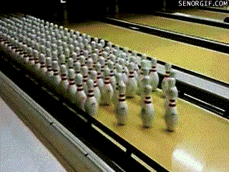
Momentum – HONORS ONLY
Law of Conservation of Momentum
Momentum is never created or destroyed, it can only be transferred from one object to the next.

Slide 6
Momentum – HONORS ONLY
Momentum is CONSERVED. Never created or destroyed, it can only be transferred.
Collisions can occur in may ways:
Two objects near each other and repel (like charged electrons)
Two objects hitting each other and bouncing off in completely opposite directions (pool balls)
Two objects hitting each other from different angles (a corner back hitting a receiver as they come from different directions)
Two objects hitting each other and sticking to each other (a baseball player catching a fly ball)
Multiple objects hitting each other and separating (think of a pool balls)
An explosion separating one objects into multiple directions. (a bomb)
We will always assume 1 dimension, with the two objects separating from each other as a result.

Slide 7
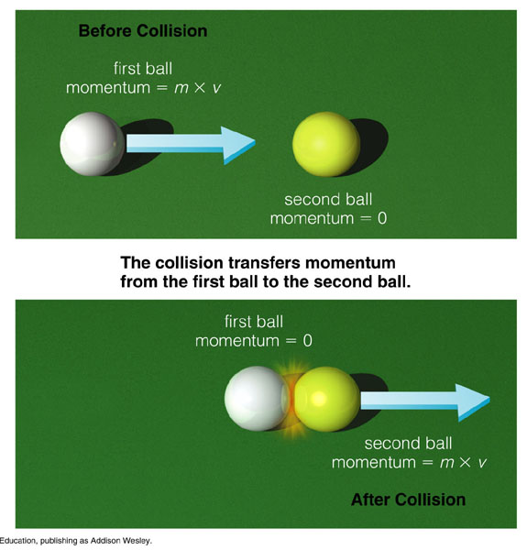
Momentum – HONORS ONLY
We will always assume perfect physics classroom scenarios for this to work:
Always assume 1 dimension
Always assume the second object will also start at rest, while the first object will stop INSTANTLY upon impact
Always assume the two objects separating from each other as a result.

Slide 8
Conservation of Momentum
This is the only type of conservation of momentum we will calculate
Stop sign ‘stops’ instantly upon impact…

Slide 9
Momentum – HONORS ONLY
Momentum is CONSERVED. Never created or destroyed. So in our simple examples…
The equation:
Momentum of Object₁ = Momentum of Object₂
P₁ = P₂
M₁ * V₁ = M₂ * V₂
M₁ = mass of 1st object M₂ = mass of 2nd object
V₁ = velocity of 1st object V₂ = velocity of 2nd object

Slide 10
Momentum – HONORS ONLY
A 3kg ball is traveling at 8m/s. If it hits an empty bottle, with a mass of 12kg, what will be the velocity that the bottle travels assuming the ball stops on impact and all momentum is transferred?
M₁ * V₁ = M₂ * V₂
So if we knew that…
3kg * 8m/s = 12kg * V₂
24kg*m/s = 12kg * V₂
V₂ = 2m/s

