Slide 1
Acceleration Graphs
Pictures worth even MORE words now!

Slide 2
RECALL…
Motion can be graphed
Acceleration is merely a change in speed over time
Knowing this, what do you think the two axis of our acceleration graphs are going to be?

Slide 3
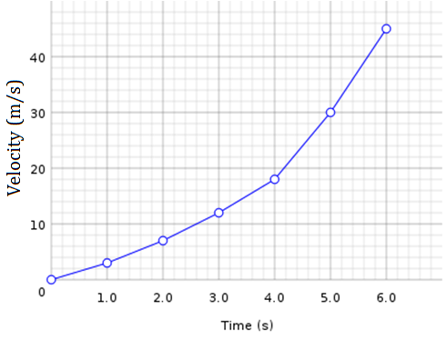
Acceleration Graphs
The vertical axis (y) will be velocity (m/s)
The horizontal axis (x) will be time (s)
SLOPE = Acceleration

Slide 4
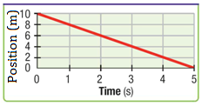
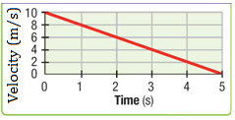
Graphing and Acceleration
Which of these is a velocity graph, and which is an acceleration graph?
How can you tell?

Slide 5
Velocity vs Time Graphs
Velocity v. Time graph shows how velocity changes over time
ANY slope at all shows an acceleration

Slide 6
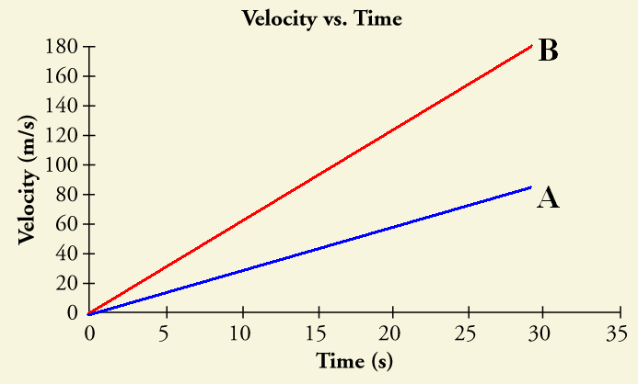
DIFFERENT SLOPES…
A POSITIVE slope means there is POSITIVE acceleration
Positive acceleration means speeding up
Which of these lines
has a greater acceleration?
B – It has a greater slope

Slide 7
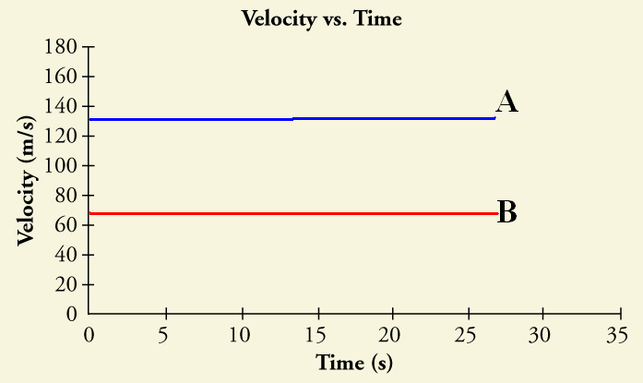
DIFFERENT SLOPES…
A slope of ZERO shows an acceleration of 0m/s²
This just means there is a constant speed
Slope of zero = horizontal line
Which of these lines
has a greater acceleration?
Neither – Both are zero
Which of these lines
has a greater velocity?
A – It has velocity of 130m/s

Slide 8
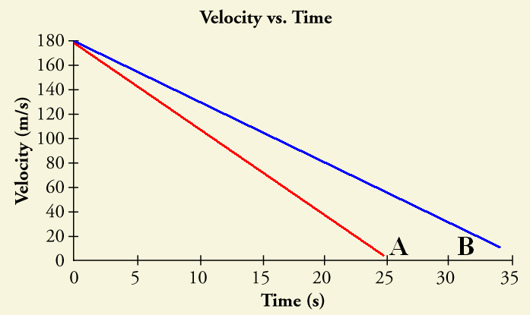
DIFFERENT SLOPES…
A NEGATIVE slope means there is NEGATIVE acceleration
Negative acceleration means slowing down
Slowing down = DECELERATING
Which of these lines
has a greater
deceleration?
A – It has a greater
slope

Slide 9
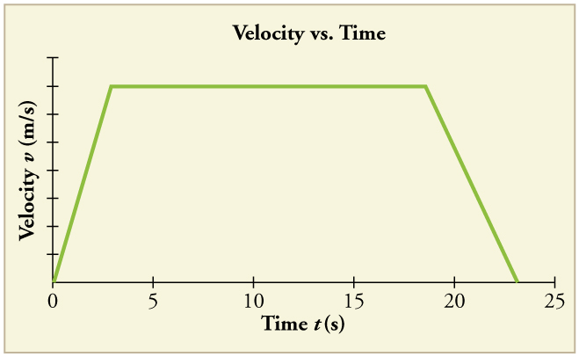
Slopes: Recap
Line slopes up Line slopes down
Velocity is increasing Velocity is decreasing
Positive acceleration Negative acceleration
Straight Horizontal line
Constant velocity
No acceleration

Slide 10
Calculating Acceleration
What is the formula for acceleration?
What is the velocity at 1 s?
What is the velocity at 4 s?
What is the acceleration between 1 and 4 seconds?
A = (Vf-Vi)
t
= (2m/s – 8m/s)
3 s
= - 6 m/s = -2 m/s²
3s

Slide 11
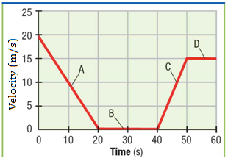
Putting it all together
Tell me what is happening for each line
A – Decelerating
B – Constant velocity (0 m/s) AND no acceleration. This is STOPPED.
C – Acceleration
D – Constant velocity (15 m/s)
AND no acceleration. This is NOT STOPPED

