Slide 1
WORK and POWER!

Slide 2
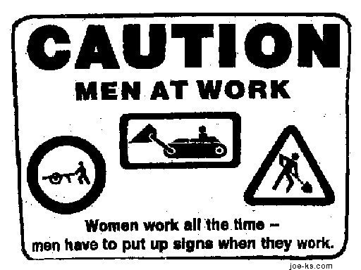
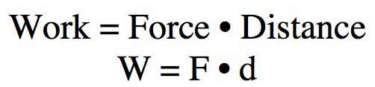
What is Work?
Work is done when a force causes a change in motion of an object
Motion of object must be in the SAME direction as the force.
Work = ZERO if there
is no motion.

Slide 3
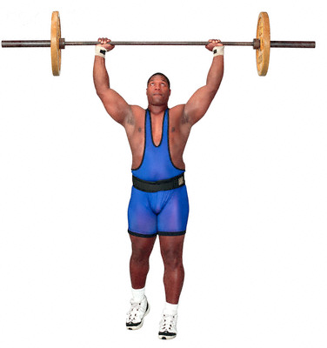
An Example
A weightlifter lifts a barbell over his head.
  Is work being done?
  Yes, the motion and the force are in the same direction.
Once the barbell is over his head, he holds it there for 3 seconds.
  Is work being done?
  No, there is no motion.

Slide 4

Another Example
Dora picks up her backback to put it on. After it is on, she runs out the door to start exploring.
  Is work being done on the bag?
  Yes, when the bag is being lifted.
  Not while Dora is carrying the bag out the door.

Slide 5
Helpful Hint
This is a GENERAL guide and not a set rule, but…
If I use the words:
  Push, Pull, Lift, or Throw, WORK was done if motion occurred
    If you are walking or running, you are working
  Carry or Hold, NO WORK was done because any motion is in a different direction from the force
    Exception: Carrying an object up stairs is work

Slide 6

The Math
Work = Force x Distance
  W = F x d
Work is measured in:
  Joules
  Newton * Meters
1 Joule = 1 N*m = 1 kg*m/s² * m

Slide 7
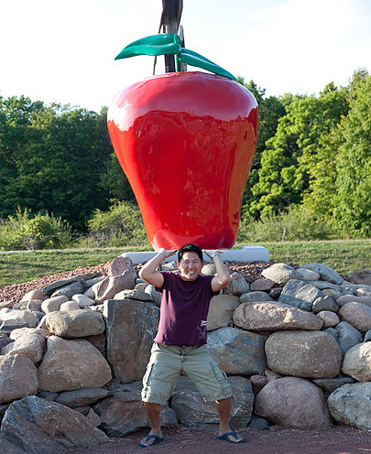
What is a Joule?
1 Joule = 1 N * m
1 joule of energy is the energy needed to lift an apple from your waist to your head.

Slide 8
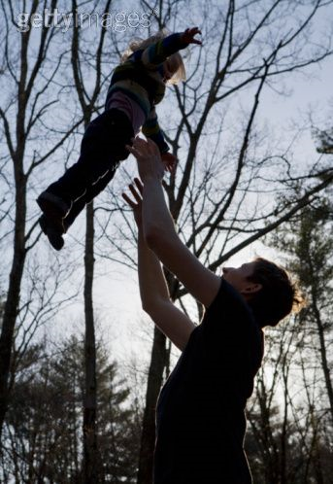
Practice
Imagine a father playing with his daughter by lifting her repeatedly in the air. How much work does he do on the child with each lift, assuming he lifts her 2.0m and exerts a force of 190 N?

Slide 9
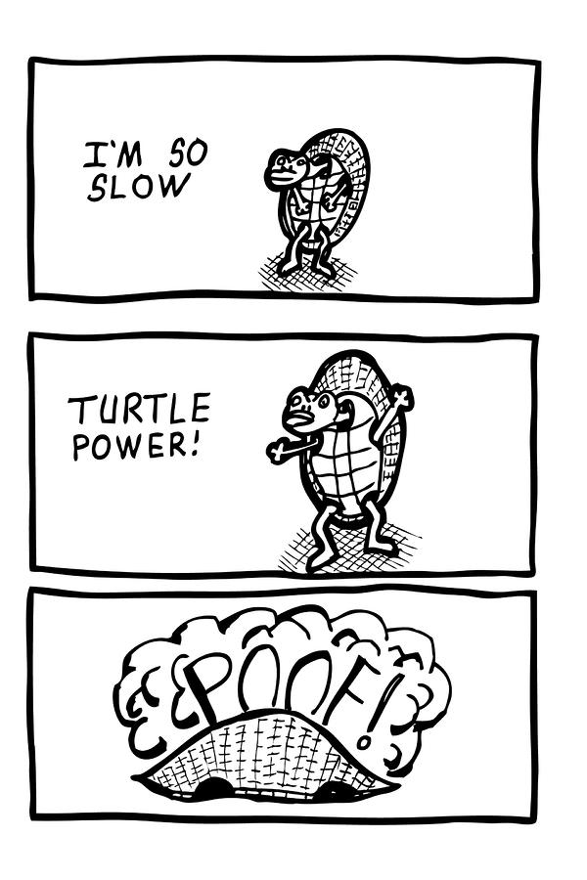
Power (HONORS ONLY)
Power is the rate at which work is done
Power = work/time
  SI Unit is the Watt
  1 watt is the amount of power needed to do 1 J of work in 1 s

Slide 10
Work vs. Power
Running and walking up a flight of stairs requires the same amount of work – How?
  Same force, same distance = same work
  Running does it faster – What does that tell you about Power?

Slide 11
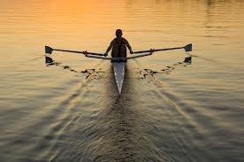
Power Practice
While rowing across the lake during a race, John does 3,960 joules of work on the oars in 60s. What is the rower’s power output?

Slide 12
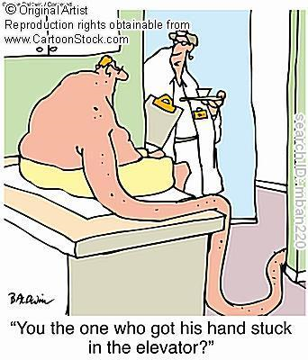
Power Practice
It takes 100 kJ of work to lift an elevator 18 m. If this is done in 20s, what is the average power of the elevator during the process? (hint: convert to joules)

Slide 13
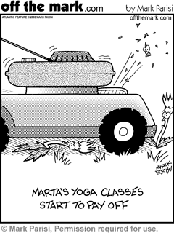
Power Practice
If a person pushes a lawn mower with a force of 500N over a distance of 20m in 120s, what was the power required?

