Slide 1
Energy!

Slide 2
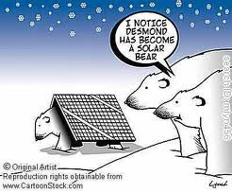
Energy!
Energy is the capacity to do work, and ability to cause motion
SI Unit = Joules (J)
1 Joule = 1 N * 1 m
1 Joule = (1 kg * m/s²) * 1m
1 Joule = 1 kg * m²/s²

Slide 3
Energy!
There are 7 forms of energy
But there are 2 broad terms that we use: kinetic and potential. Each of the 7 types have a form of kinetic and potential.
Basically:
Potential = stored energy
Kinetic = energy of motion
We will look at the 7, then zoom in on KE and PE a bit more.

Slide 4
The 7 Types of Energy!
Mechanical Energy
Chemical Energy
Electrical Energy
Nuclear Energy
Thermal Energy
Radiant Energy
Sound Energy
And remember, each one of these 7 has a form of potential energy and each has a form of kinetic energy

Slide 5
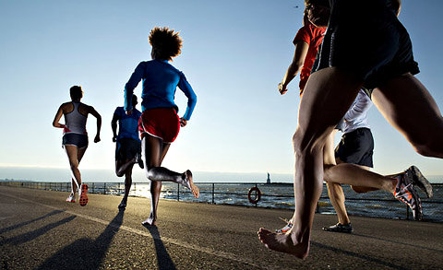
The 7 Types of Energy!
Mechanical Energy – the energy stored in an object due to its motion or position.
Mech Kinetic Energy: a moving car, a cheetah running
Mech Potential Energy: stored in a spring, compressed ball, or a plane in the air
Examples:
A running kid, a flying plane, a potted plant sitting on a ledge

Slide 6
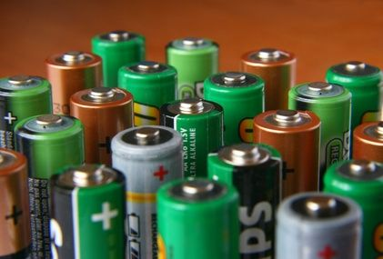
The 7 Types of Energy!
2) Chemical Energy – Energy stored in the bonds that hold them together.
Chem Potential Energy: stored in a battery or ethanol
This energy changes into another form during chemical reactions.
Examples:
Food, batteries, humans, gasoline, trees, etc.

Slide 7
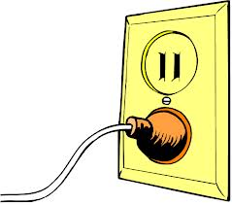
The 7 Types of Energy!
3) Electrical Energy – Energy of electrons
moving around a circuit.
Elec Kinetic Energy: movement of electrons
Elec Potential Energy: stored in a capacitor
4) Nuclear Energy – Energy associated with the nucleus
Nuclear Kinetic Energy: movement of protons and neutrons
Nuclear Potential Energy: stored in the forces binding the nucleus together; unstable nuclei

Slide 8
The 7 Types of Energy!
5) Thermal Energy – type of energy that comes from heat and vibration of molecules.
6) Light/Radiant Energy – energy associated with electromagnetic spectrum and light waves.
Radiant Kinetic Energy: movement of photons
7) Sound Energy – Energy that is associated with the movement of sound waves.
Sound Kinetic Energy: movement of atoms/molecules

Slide 9
The 7 Types of Energy!
Mechanical Energy
Chemical Energy
Electrical Energy
Nuclear Energy
Thermal Energy
Radiant Energy
Sound Energy
And remember, each one of these 7 has a form of potential energy and each has a form of kinetic energy

Slide 10
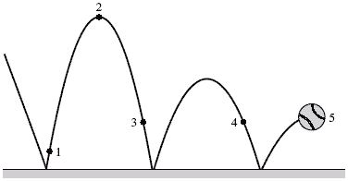
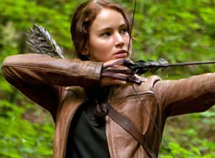
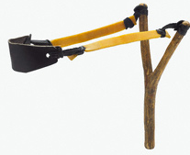
Potential Energy
Energy stored due to position or shape. It has the ability or “potential” to move.
There are 2 types:
1) Elastic – energy stored by things that stretch (or compress).
Examples? - Rubber bands, sling shots, elastic,
muscles, a spring, a ball bouncing, etc…

Slide 11
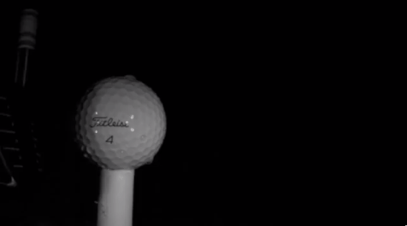
Elastic Potential Energy
Much of the “pop” of a golf ball off of a drive is the amount of compression within the impact. The golf ball wants to return to its normal shape…

Slide 12
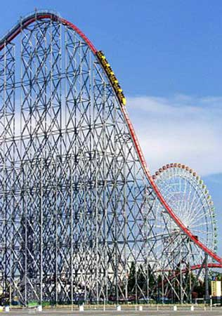
Potential Energy
Remember energy stored due to position. It has the ability or “potential” to move.
There are 2 types:
2) Gravitational Potential Energy- energy stored by objects that are lifted off the ground.
Grav Potent Energy = mass * gravity * height
A 65kg rock climber ascends a cliff. What is the climber’s GPE at a point 35m above the base of the cliff?
GPE = m * g * h
GPE = 65kg * 9.8m/s² * 35m
GPE = 22295 joules

Slide 13
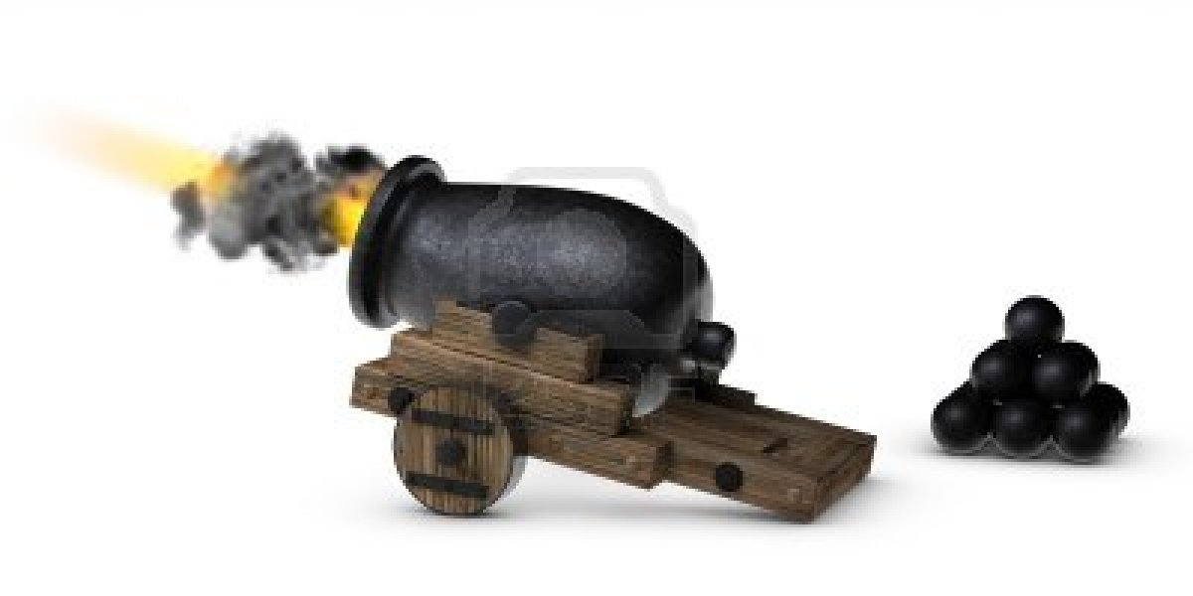
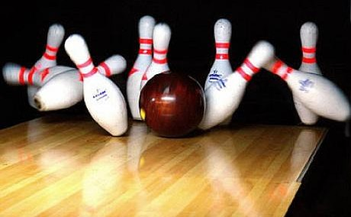
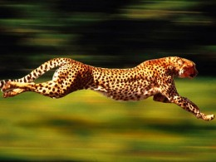
Kinetic Energy
Kinetic – energy of motion. Amount of energy depends on objects mass and velocity.
Formula
KE = ½ m * v²
Units = Joules

Slide 14
Kinetic Energy
Remember kinetic energy is the energy of motion.
Formula
KE = ½ m * v²
Units = Joules (remember 1J = 1N * 1m/s)
Practice: What is the Kinetic Energy of a 44kg cheetah running at 31m/s?
KE = ½ m * v²
KE = ½ (44 kg) * (31m/s)²
KE = ½ (44 kg) * 916m²/s²
KE = 21,142 joules

Slide 15
Law of Conservation of Energy
Energy can never be created and never destroyed. Energy can only change from one form to another.
Net Energy is the total amount of energy in a system.
The total or net amount of energy must stay the same when energy changes forms.

Slide 16
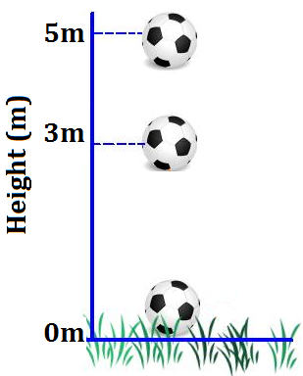
Law of Conservation of Energy
Before the drop
If the 4kg soccer ball is held at a height of 5m, how much GPE does it have?
GPE = M * G * H = 196 joules of GPE
If the 4kg soccer ball is held at a height of 5m, how much KE does it have?
KE = ½ mv² = 0 joules of KE (not moving)

Slide 17
Law of Conservation of Energy
After the drop…
If the 4kg soccer ball is dropped, how much GPE does it have when it strikes the ground at 0m?
GPE = M * G * H = 0 joules of GPE (height is 0m)
If the 4kg soccer ball is dropped, what is the velocity when the ball strikes the ground at 0 m?
KE = ½ mv² = 196 joules of KE
M = 4kg
V = 9.899 m/s at impact

Slide 18
Law of Conservation of Energy
Recap:
So for an object that is going to simply “fall”
GPE at the Drop Point = KE at the Impact Point
Because all of the GPE is converted to KE throughout the fall
This only works for “falling” objects though….
A roller coaster is not falling, per se…

Slide 19
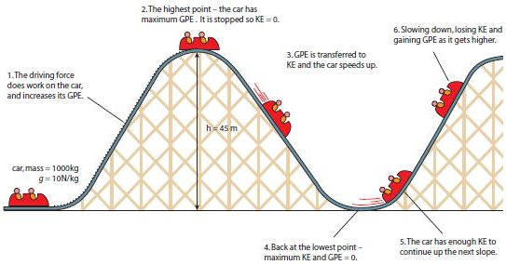
But a Roller Coaster is not just a fall…
As we start at the top of the 1st hill…

Slide 20
Energy Changes on the Roller Coaster
We saw on previous slide that the GPE the car has at the top of the 1st hill will turn into KE as the car travels down the hill.
And that the KE the car has at the bottom of the 1st hill will turn into GPE as the car travels up the next hill.
But is this a perfect
transformation of
energy from
GPE to KE
and back?
Nope. Energy is lost as heat and sound.

Slide 21
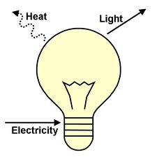
Energy Conversions
Explain what energy we are starting with and what energy we are ending with for the following products:
A Lightbulb
Start with __Electricity_ → End with ___Light__ Waste __Heat___
Can you determine the other 4 energy conversions? Remember: Law of Conservation of Energy…
A fan Start with __________ End with _________ Waste ________
A battery Start with __________ End with _________ Waste ________
A fire Start with __________ End with _________ Waste ________
A glowstick Start with __________ End with _________ Waste ________

Slide 22
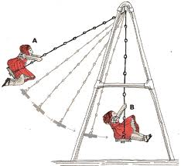
Energy Conversion Example:
As a swing moves back and forth, the energy is converting from one form to another…..
Why will the swing eventually stop?
In what form will that energy be transferred into?

Slide 23
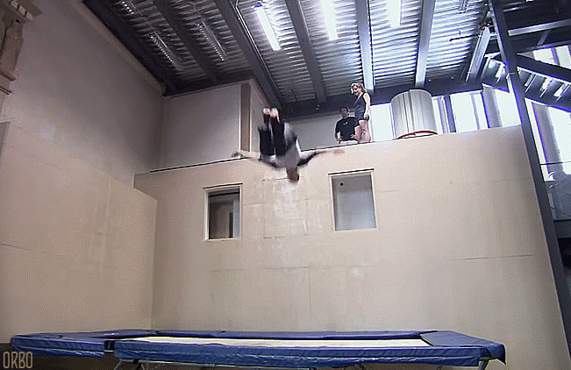
Explain this conversion of energy
Using the words gravitational potential energy, elastic potential energy, kinetic energy, and gravity…
You should also
be able to discuss
Newton’s 3 Laws…

Slide 24
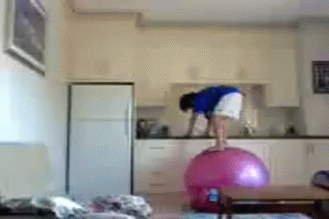
Explain this conversion of energy
Using the words gravitational potential energy, elastic potential energy, kinetic energy, and gravity…
You should also
be able to discuss
Newton’s 3 Laws…

