Slide 1
Electric Charges

Slide 2
A little chemistry
All matter is made up of atoms
Atoms are made of protons, neutrons, and electrons
Protons: (+)
Neutrons ( no charge )
Electrons: (-)
Atoms can have a positive charge, a negative charge, or no charge at all.

Slide 3
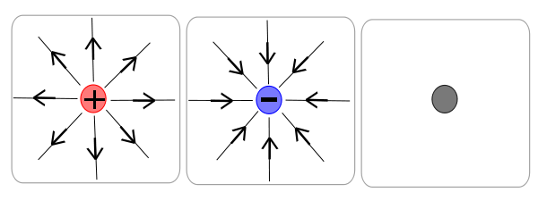
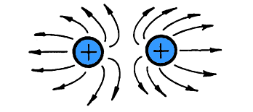
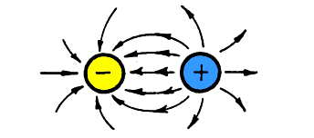
Charges
Electrical charge – caused by an imbalance of protons and electrons
Positive (more protons than electrons)
Negative (more electrons than protons)
Neutral (same number of protons and electrons)
(Electric Fields of each shown above…)
Opposites attract
Likes repel

Slide 4
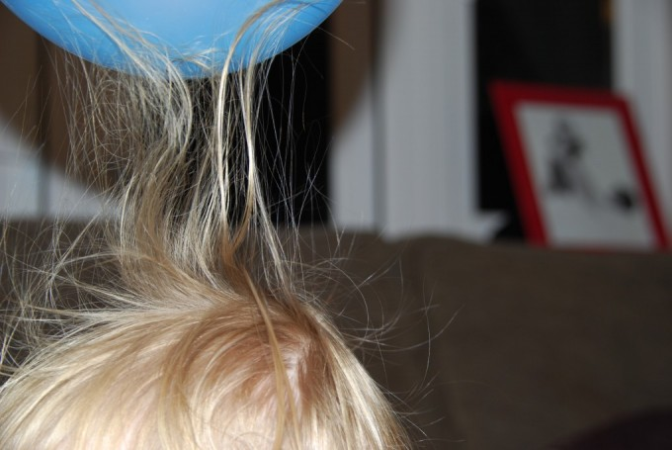
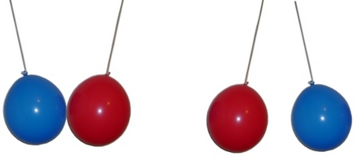
More Chemistry
A charge can never be created or destroyed.
It is transferred from one object to another.
This happens when electrons move from one object to another
Opposite Charge
Like Charge

Slide 5
Transferring Charge
Electric energy is never created or destroyed, only transferred
Objects (generally those that are conductors) can become charged by one of 3 ways:
Induction
Conduction
Friction

Slide 6
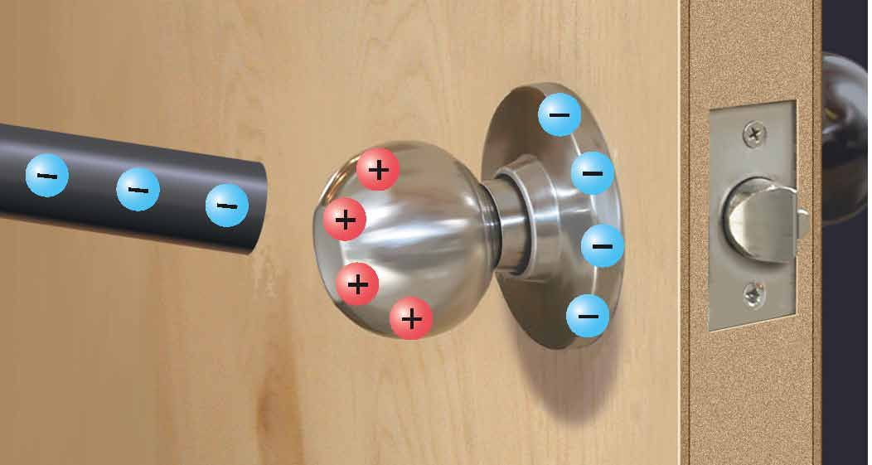
Transferring Charge
Induction – Transferring a charge by bringing a charged object NEAR a neutral object without touching it.
The total charge on the door knob will still be neutral, but the opposite sides will have opposite charges

Slide 7
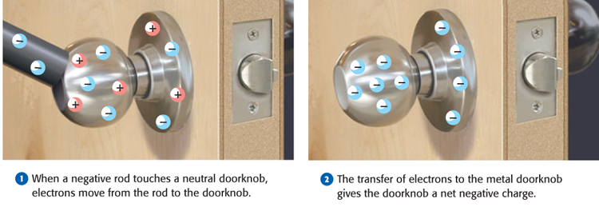
Transferring Charges
Conduction - Electrons are transferred from one object to another by contact, or touching.
When a negatively charged rod touches a neutral door knob, electrons transfer from the rod to the doorknob to give the doorknob a negative charge

Slide 8
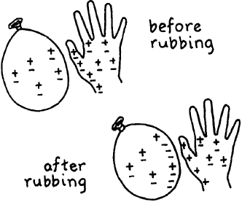
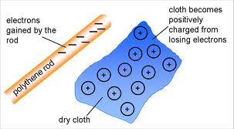
Transferring Charge
Friction - two objects rub up against each other, leaving electrons built up on one side. Both objects become charged.
i.e. rubbing a balloon on your head, walking across carpet, wool rubbing on metal…

Slide 9
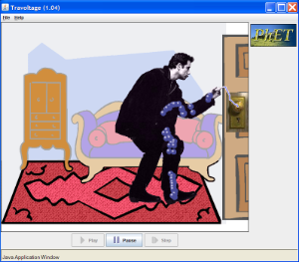
Static Discharge
John Travoltage!!
http://phet.colorado.edu/en/simulation/travoltage

Slide 10
Lightning

Slide 11
Controlling the Path of Electric Charge
Electrical Conductor: a material in which charges move freely
i.e. metal (wires) and water
Electrical Insulator: a material in which charges cannot move freely
i.e. plastic, wood, glass, foam, cloth, ceramic

Slide 12
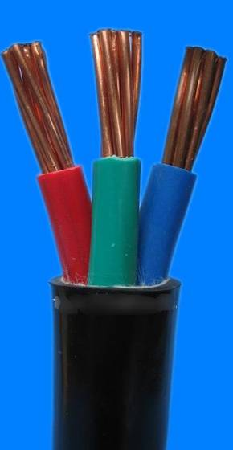
Controlling the Path of Electric Charge
Electrical Conductor:
the metal inside the cord presents a path of little resistance for the charge to flow
Electrical Insulator:
the rubber/plastic has a high resistance, to keep the charge from leaving the metal path of wire
(and to ensure you don’t shock yourself when you touch the cord!)

