Slide 1
CURRENTS AND OHM’S LAW

Slide 2
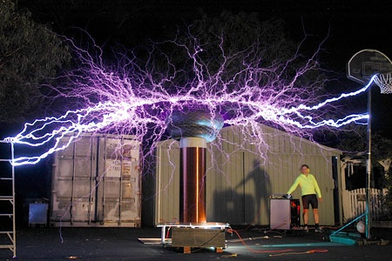
What?
Electricity – flow of electric current
Electric current – the movement of an electrical charge.
In most cases, we
think of an electric
current running
through a circuit.
→ In comes Ohm’s Law.

Slide 3
Ohm’s Law
V = I x R
V = Voltage (units are volts, v)
I = Current (units are ampres, A)
R = Resistance (units are ohms, Ω)

Slide 4
Voltage
Voltage is the difference in electrical potential between two places where electrons are flowing.
A negative charge (electron) wants to move away from other negative charges (other electrons.)
These repulsive forces increase as electrons are closer to each other.
Electrons flow from high potential energy to low potential.
This potential difference is usually just called voltage
Voltage provides the energy that pushes and pulls electrons through the circuit.
Voltage is measured in Volts (V)

Slide 5
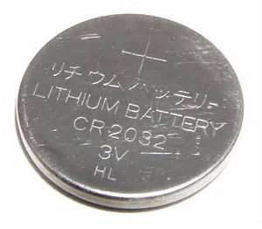
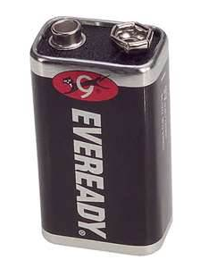
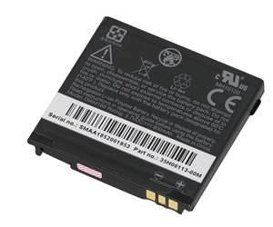
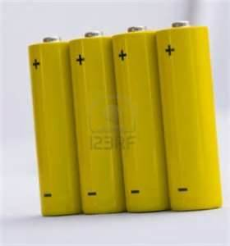
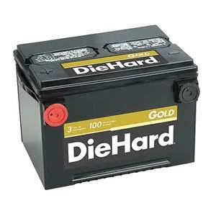
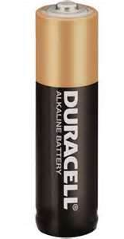
Batteries
Batteries can have different voltage, and therefore push different strength currents
Range from 1.5 volts to 12 volts
Batteries have a positive terminal and a negative terminal.
Electrons are pushed from the negative terminal and are pulled towards the positive terminal
BUT current is in the opposite direction

Slide 6
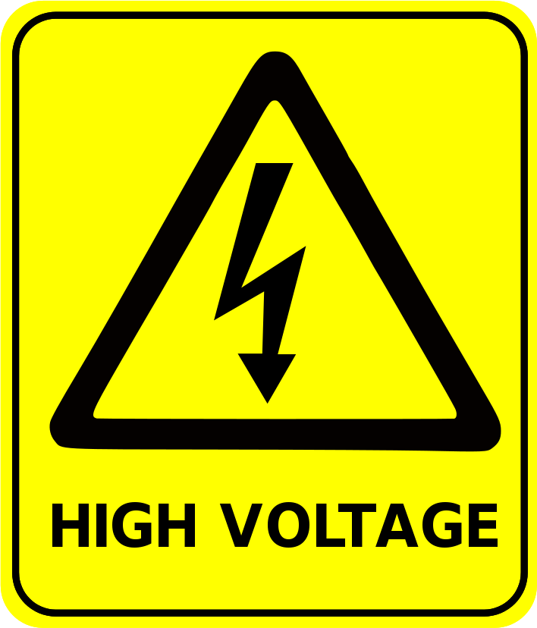
Voltage
Basically…
Voltage is potential electrical difference that sets a charge in motion
Voltage is the PUSH and is measured in Volts (V)

Slide 7
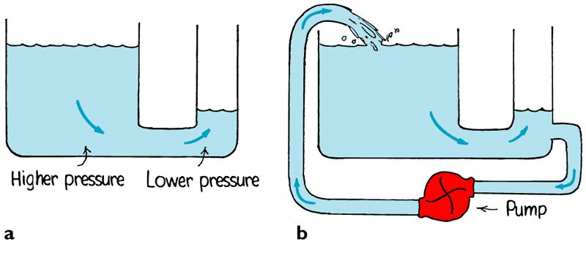
Current: General Idea
An object moving in a specific direction
Current can be water, air, cars, or charge
Current is caused because of a difference in pressure on either side of an object
Once the difference in pressure is gone, current stops
Pumps & Batteries are used to maintain a difference in pressure.

Slide 8
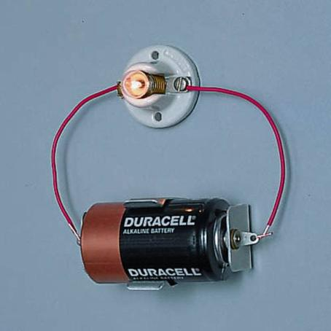
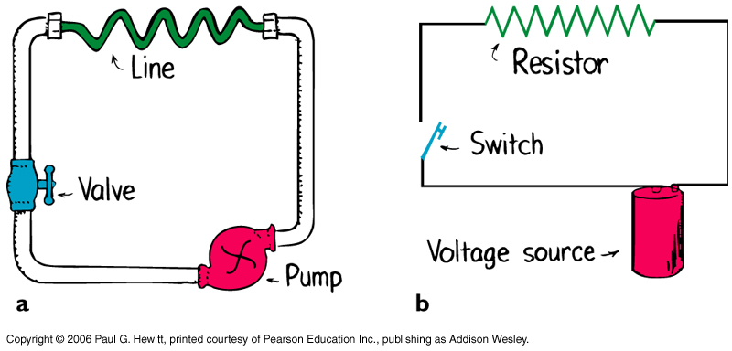
Electric Current
Just as water current is flow of water molecules, electric current is the flow of electric charge.
Measured in Amperes (A)
In metal circuits, moving electrons make up the flow of charge.
Electrons travel
negative to positive
Current travels in
the OPPOSITE direction
as electrons do.

Slide 9
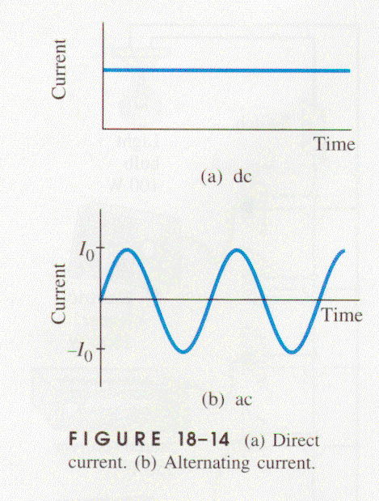
Types of Current
THERE ARE TWO TYPES OF CURRENT:
In a direct current (DC) the current always moves from one terminal to the other in the same direction.
- example: battery
In an alternating current (AC) the current will
always alternate directions at regular intervals.
- example: appliances at home
Remember, direction of the current is
opposite the direction of electron flow.

Slide 10
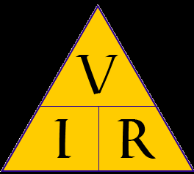
Voltage and Current
Voltage PUSHES charges through circuits.
Current is how fast electrons FLOW thru the circuit
Example – you could say that…
Amps measure how much water comes out of a hose.
Volts measure how hard the water comes out of a hose.
Basically: As Voltage Increases,
Current Increases!

Slide 11
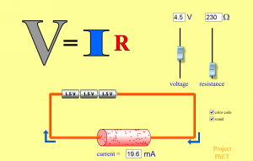
Practice!
So how does this relate to awesome computer simulations?
http://phet.colorado.edu/en/simulation/ohms-law

Slide 12
Resistance (R)
Objects use different amount of power because they have different amounts of current running through them.
The difference in current is due to the resistance.

Slide 13
Resistance (R)
Resistance: the tendency for a material to oppose the flow of electrons, changing electrical energy into thermal energy and light.
Resistance is caused by internal friction, which slows the movement of charges through a conducting material.
Resistance is measured in Ohms (Ω).

Slide 14
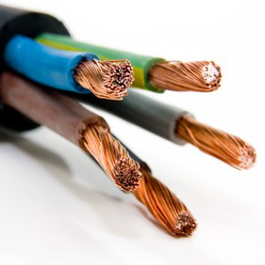
Resistance and Wires…
Conductors have low resistance
The better the conductor, the better that electrons will move through the material in the presence of an electric field
ie: metal wires
Insulators have high resistance
The better the insulator, the more
that the substance will resist the
movement of electrons.
ie: plastic or rubber

Slide 15
Resistance (R)
The resistance of a light bulb filament determines how bright the bulb will be
The filament of a 40watt bulb has a much higher resistance than a 100watt bulb
This is because more resistance = less current = dimmer bulb
So being able to control resistance would be a good thing…
2 ways that we can increase resistance in a wire:
make the wire longer (ie: the loops)
make wire thinner
Thicker wire = less resistance
Thin wire = more resistance

Slide 16
Ohm’s Law
V = I x R
V = Voltage (units are volts, v)
I = Current (units are ampres, A)
R = Resistance (units are ohms, Ω)

Slide 17
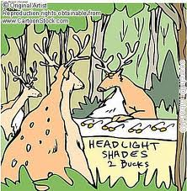
Practice!
The headlights of a typical car are powered by a 12V battery. What is the resistance of the headlights if they draw 3.0 A of current when turned on?
Use your Ohm’s Law Triangle
- Insert your values
- Use units
- Solve!

