Slide 1
Series and Parallel Circuits

Slide 2
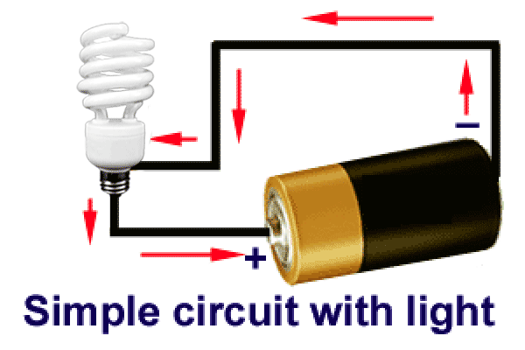
Circuits
Provides a path for electricity to travel
Similar to water pipes in your house
Because of the voltage of an outlet, electrons will travel through the circuit
Electrons NEED to travel
around the ENTIRE path
for anything to work

Slide 3
Open vs. Closed Circuits
When there is a complete path, the circuit is considered a closed circuit.
When there is NOT a complete path, the circuit is considered an open circuit.
A switch allows you to open and close a circuit

Slide 4
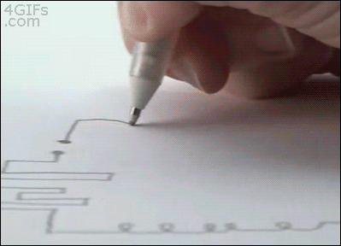
Conductive Ink!!!
The ink on this page conducts electricity (yes, it is special ink).
What happens to the _________ when the page is folded over?
… to the circuit?
… to the lightbulb?
… to the current?

Slide 5
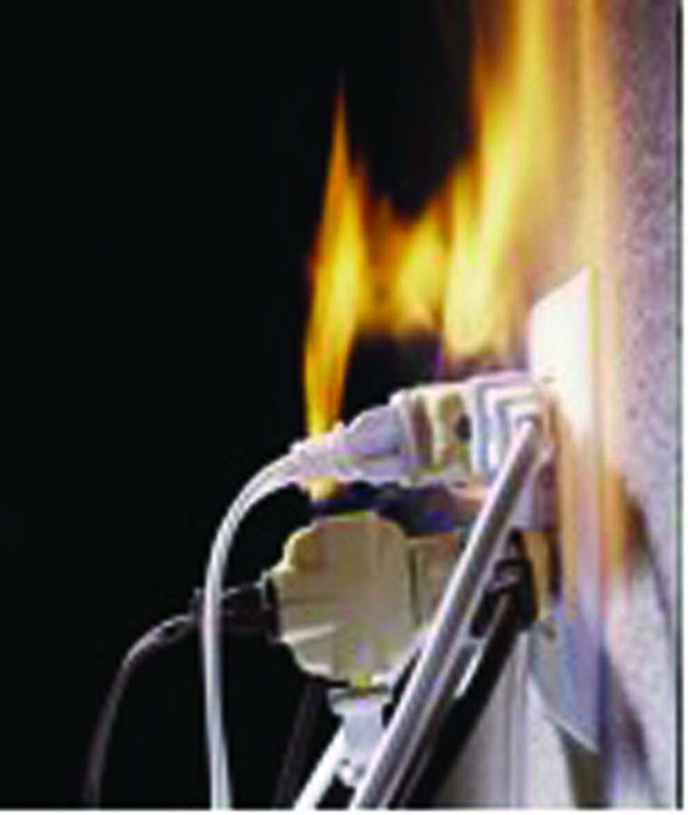
Safety Precautions
If too many devices (tv, radio, hair dryer, etc) are connected to an outlet, the overall resistance of the circuit is lowered
This increases the current traveling through the circuit, possibly more than a safe level of current.
This is called an overloaded circuit.
Too much current traveling though
a wire can cause fires.

Slide 6
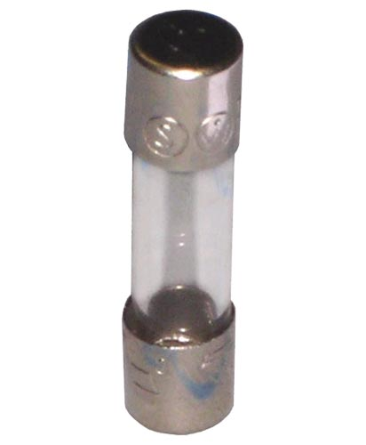
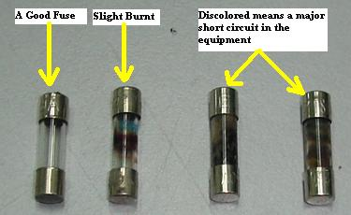
Safety Precautions
Both of these objects open the circuit by disrupting the complete circle, preventing damage to the rest of the circuit.
FUSE – a ribbon of metal wire that melts when too much current flows through it
If current becomes to high,
the fuse melts, and the
circuit is open
Can only be used once
then must be replaced

Slide 7
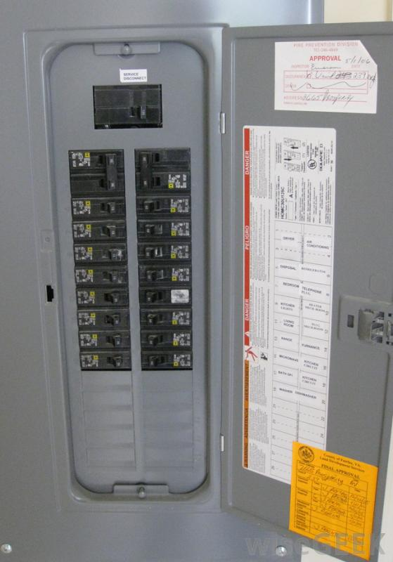
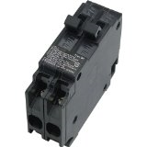
Safety Precautions
Circuit Breaker opens a circuit with a high current
Uses an electromagnet that responds to current overload by opening the circuit
Basically it is magnetic switch that ‘trips’
The circuit breaker acts as a switch.
Can be used multiple times. Must be reset once “tripped”.

Slide 8
Circuit Diagrams
Uses symbols to represent parts of a circuit
Shorthand way to describe a real circuit

Slide 9
Circuit Symbols: How to Draw
Remember, the circuit drawing needs to be a COMPLETE path.
Electrical Supply
(Battery)
On – Off Switch
Resistor
Light Bulb

Slide 10
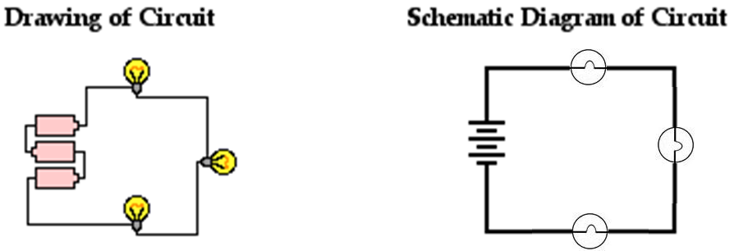
Circuit Symbols: How to Draw

Slide 11
You try to draw some circuits:
A circuit with one resistor, one battery, and one switch.
A circuit with two resistors, three batteries, and one switch.

Slide 12
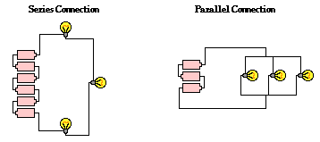
Circuits: 2 Diff Types
Can either be series or parallel.
Series: 1 path Parallel: 2+ Paths

Slide 13
Overview: Series v Parallel Circuits
 | Series | Parallel
Pathways for electrons and current | Only 1 path. | Multiple Pathways for current
Current (I) | Always the same throughout | Different at each branch – MUST CALCULATE
Voltage (V) | VOLTAGE DROP after every resistor/bulb: MUST CALCULATE each separately | Each Branch starts with same voltage (Voltage drops to 0v after each branch)
Resistance (Ω) | Add up all to get total resistance | Each branch different - MUST CALCULATE each branch separately – Ohm’s Law

Slide 14
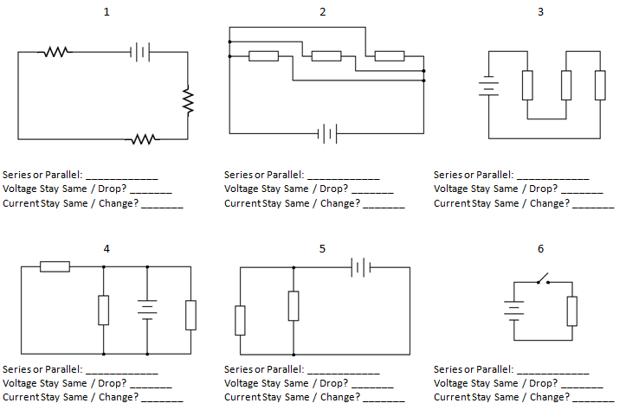
Let’s Practice: Identify WS…

Slide 15
Try some drawings!
1) Series: with 2 resistors (one is 4 ohm, one is 7ohm), a 12V battery, and a 10 ohm light bulb.
2) Parallel: with a 1.5 volt battery and 3 light bulbs (each on its own branch). Light bulbs have a resistance of 2, 4, and 6 ohms.
3) Series: 6v battery, one switch, one 20ohm resistor.
4) Parallel: 12volt battery, 3 light bulbs. 2 light bulbs (2 and 3 ohms) are on one branch, while the 3rd light bulb (8ohms) is on another branch)

Slide 16
Circuits: 2 Diff Types
Can either be series or parallel.
Series: 1 path Parallel: 2+ Paths

Slide 17
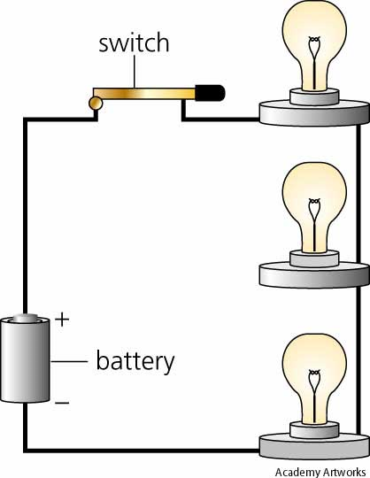
Series circuits
There is only 1 path for current/electrons to travel
If the circuit opens in any way, the whole circuits stops working because current STOPS.

Slide 18
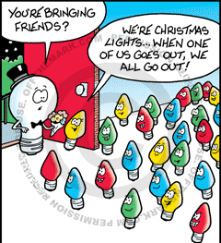
Series Circuits
Current only takes one path for electrons
If you remove a light bulb or one burns out—the ENTIRE circuit stops working!
Current stays the same
as it flows through every
part of the circuit
Resistance (and therefore
voltage), will change at different
points on a series circuit

Slide 19
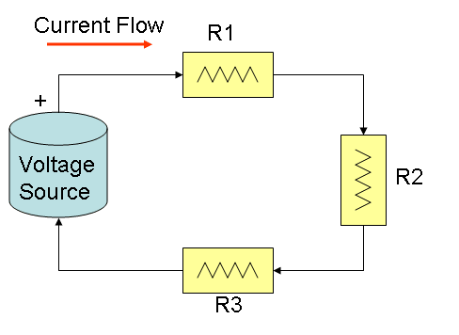
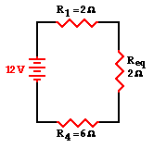
Current in Series
Current is the same at all points
Electric current always FLOWS from positive (+) to negative (-)
Which is OPPOSITE the flow of electrons.
Use Ohm’s Law to find current using total resistance and voltage

Slide 20
Resistance in Series
Add up all resistors to get total resistance
Current MUST go through each resistor in series because there is only one path.

Slide 21
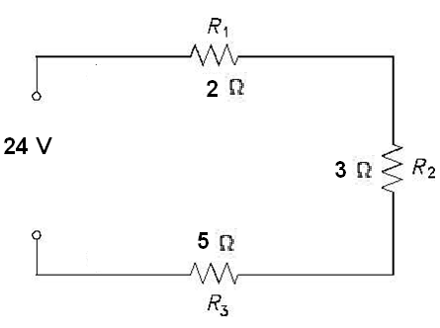
Voltage Series
Voltage “drops” after each resistor has been passed.
Calculate voltage drop by calculating voltage at each resistor
V = I*R
V = (current * resistor)

Slide 22
Sample Problem #1
Draw a series circuit with a 3 different1.5 V batteries (all together), 2 equal resistors, and a current of 0.5 A.
What is the total voltage of the circuit?
3 * 1.5 volts = 4.5 volts
What is the total resistance of the circuit?
V = IR 4.5v / 0.5A = 9ohms
What is the resistance of each resistor?
9ohms / 2 equal resistors = 4.5 ohms each

Slide 23
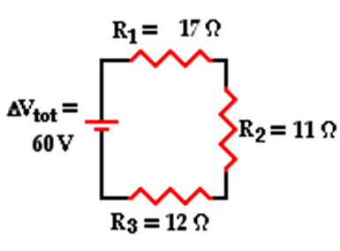
Sample Problem #2
What is the total resistance of the circuit?
17ohms + 12ohms + 11ohms = 40 ohms
What is the current for the circuit?
V = IR → 60 volts / 40ohms = 1.5amps
What is the voltage drop across each resistor?
V₁ = IR
V₁ = 1.5a * 17ohm
V₁ = 25.5v
V₂ = IR
V₂ = 1.5a * 11ohm
V₂ = 16.5v
V₃ = IR
V₃ = 1.5a * 12ohm
V₃ = 18v

Slide 24
Parallel Circuits
Have more than one path for current to flow
Paths are also known as branches
If you remove a resistor, the other branches still work

Slide 25
Voltage in Parallel
Voltage is the same across each branch
because each branch is on the same wire
Voltage will drop to 0v after each branch.
But we won’t calculate that…

Slide 26
Current in Parallel
Current depends on resistance in each branch
The current in each branch will be different if the resistors have different values
It one branch has less resistance, more charge will move through it because that bulb offers less opposition to the movement of current.
The sum of the currents on each of the branches MUST equal the total starting current
EACH BRANCH is
calculated using
Ohm’s Law

Slide 27
Practice problem #3
Draw a parallel circuit with two resistors, one 2 ohm and one 3 ohm (one on each branch) and a 12 V battery.
What is the voltage through each resistor?
12 volts
What is the current flowing through each branch?
V = IR 12v/2ohms = 6v 12v/3ohm = 4v
What is the total current?
6v + 4v = 10v

Slide 28
Overview: Series v Parallel Circuits
 | Series | Parallel
Pathways for electrons and current | Only 1 path. | Multiple Pathways for current
Current (I) | Always the same throughout | Different at each branch – MUST CALCULATE
Voltage (V) | VOLTAGE DROP after every resistor/bulb: MUST CALCULATE each separately | Each Branch starts with same voltage (Voltage drops to 0v after each branch)
Resistance (Ω) | Add up all to get total resistance | Each branch different - MUST CALCULATE each branch separately – Ohm’s Law

