Slide 1
Magnets and Electricity

Slide 2
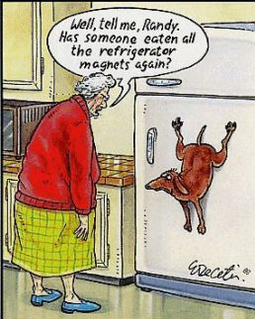
Magnets
A magnet is an object that produces a magnetic field.
Magnets can be natural or man made

Slide 3
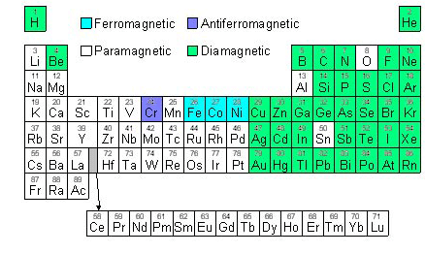
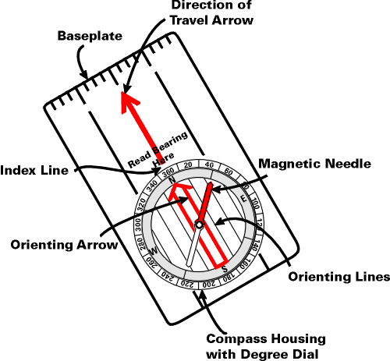
Magnetic Elements
Elements that can be magnetic
Fe: Iron soft iron loses magnetism easily
Co: Cobalt used to harden tools
Ni: Nickel used to make jewelry
Gd: Gadolinium
Other magnets:
Compass
Earth

Slide 4
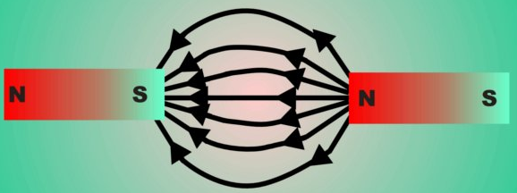
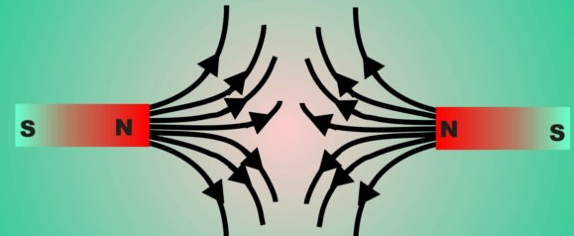
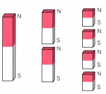
MAGNET PROPERTIES
All magnets have 2 poles:
North and South
Laws of attraction still applies
Like poles repel, opposite poles attract
All magnetic items (permanent or temporary) have atoms that line up based on their poles
If a magnet is cut, each piece will still have two poles

Slide 5
Permanent Magnets
Substances that are magnetic all the time
Can change anything into a magnet by rubbing a permanent magnet over it several times
Permanent magnets can have magnetic properties but not always be a magnet (ex: iron)
Permanent magnets can last for minutes, or forever

Slide 6
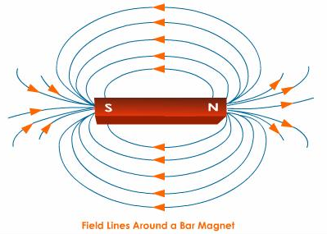
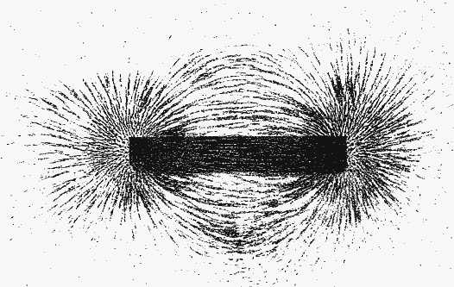
MAGNETIC FIELDS
An area where the force exists; area where force is felt
Magnetic field lines
Cause the interactions (attract or repel) between magnets
Leaves north pole & enters south pole
Lines closer together = stronger field
NOTICE
Strongest at the poles
Field lines start at the NORTH pole and travel towards the SOUTH pole

Slide 7
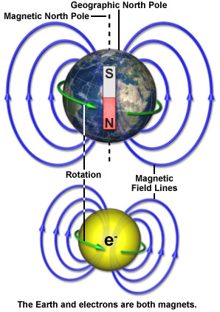
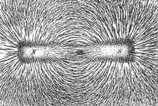
Magnetic Fields
Below: Iron filings placed over a magnet align with the magnetic field of the magnet

Slide 8
Magnetism and Electric Currents
Electric currents produce magnetic fields
Magnetism is produced by moving electric charges
The magnetic field of a coil of wire resembles that of a bar magnet

Slide 9
Electromagnets
A strong magnet created when an iron core is inserted into the center of a current-carrying coil of wire
Strength depends on:
Thicker wire
Thicker wire = less resistance
the number of loops in the wire
More loops = stronger
the amount of current
More current = stronger
And remember, more voltage means more current
size of the iron core
Bigger core = stronger

Slide 10
Electromagnets
So why are electromagnets useful?
Can turn them on / off
Cutting the current off turns off the magnet
Can control their strength
Just like we talked about last slide.
More current and voltage
Bigger Iron core
More coils around the iron core

Slide 11
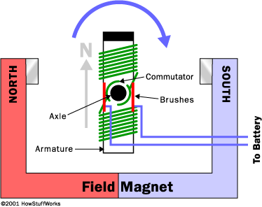
Motors
Electric motors change electrical energy to mechanical energy
Done by running an electric current through coils to make an electromagnet.
When the electric current runs through the armature, it becomes magnetized
The armature spins because motors use other magnets to push and pull the armature and create motion.

Slide 12
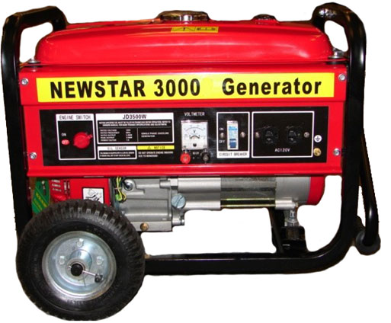
Generators
Change mechanical energy into electric energy
Done by moving a coil past a magnetic field.
Use electromagnetic induction to produce an electric current.
When a coil of wire moves through a magnetic field an electric current can be produced. This is electromagnetic induction.
Produces AC current.

